Slide 1

CML’s 91st Annual Conference
June 18 – 21, 2013
Vail, Colorado

Slide 2
REVITALI ZE Your Community with
LiveWell Colorado’s HEAL Cities & Towns Campaign
Vicky Quinlin, Council Member, Brush!
Monty Torres, City Administrator, Brush!
Ted Heyd, Community Coordinator, LiveWell Wheat Ridge
Ken Johnstone, Community Development Director, Wheat Ridge

Slide 3

HEAL = Healthy Eating and Active Living
A partnership between LWC and CML
Provides technical assistance and training to incorporate HEAL in municipal policies

Slide 4
Why a Campaign?
Engaging municipal officials in promoting HEAL through policy and environmental change
HEAL in municipal policies = healthy options for residents
Healthy communities = positive economic driver
Focus on low- and no-cost policy solutions
Colorado spent $1.637 billion treating diseases and condition related to obesity in 2009

Slide 5
Learn More
Julie George, Director, HEAL Cities & Towns Campaign
juliegeorge@livewellcolorado.org
720-353-4120, x217 or 720-233-4662
LiveWellColorado.org/HEALCampaign

Slide 6
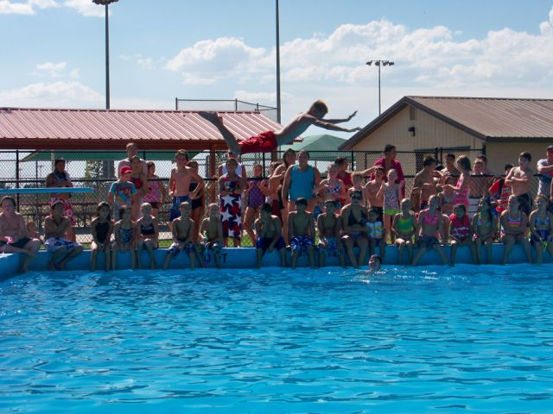
City of Brush!
A Healthy Way of Life!

Slide 7
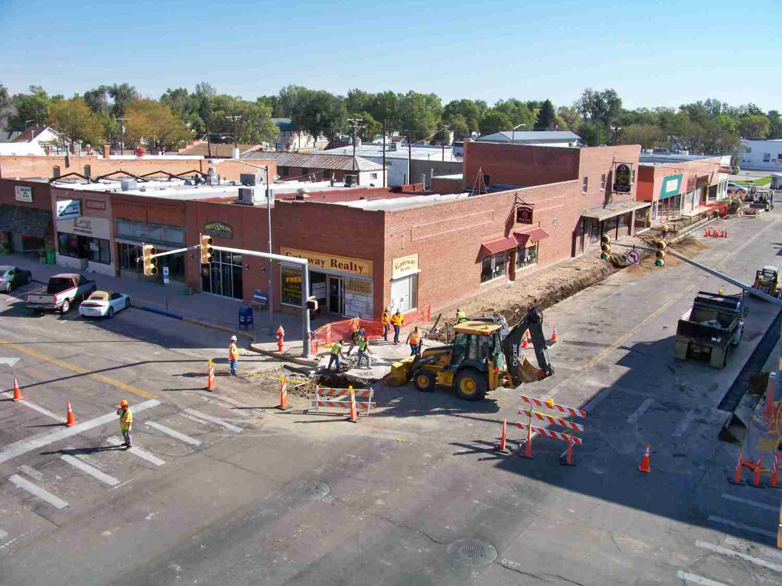
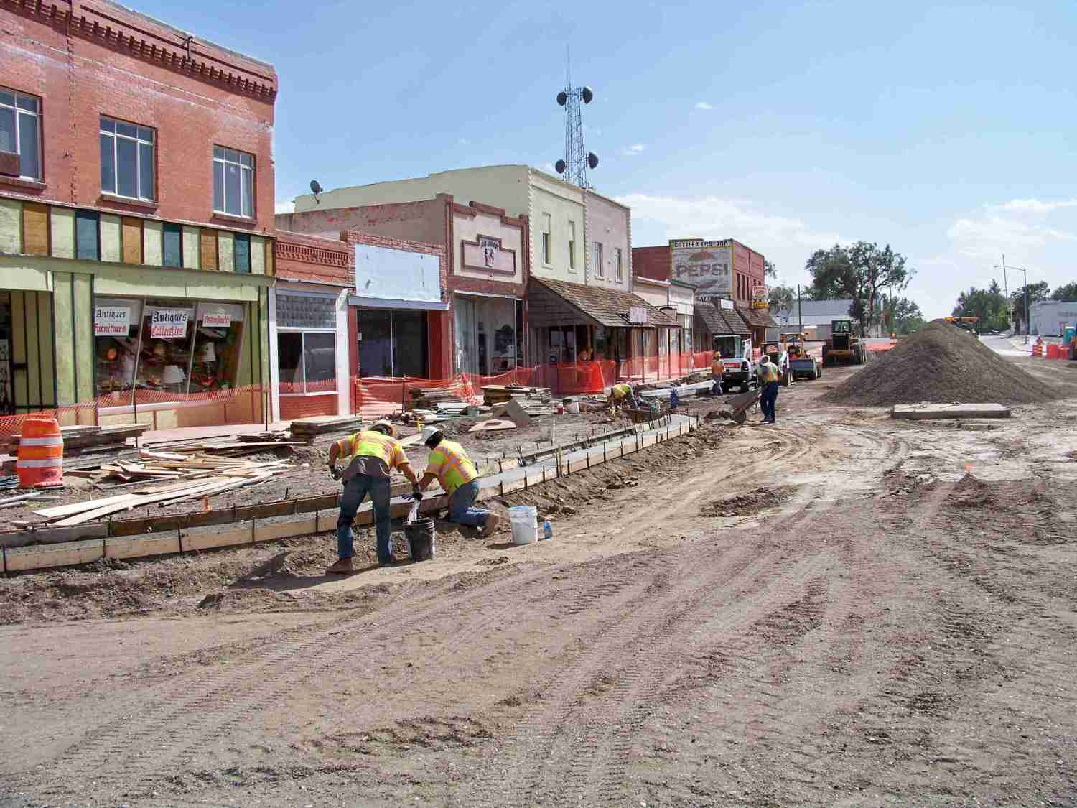
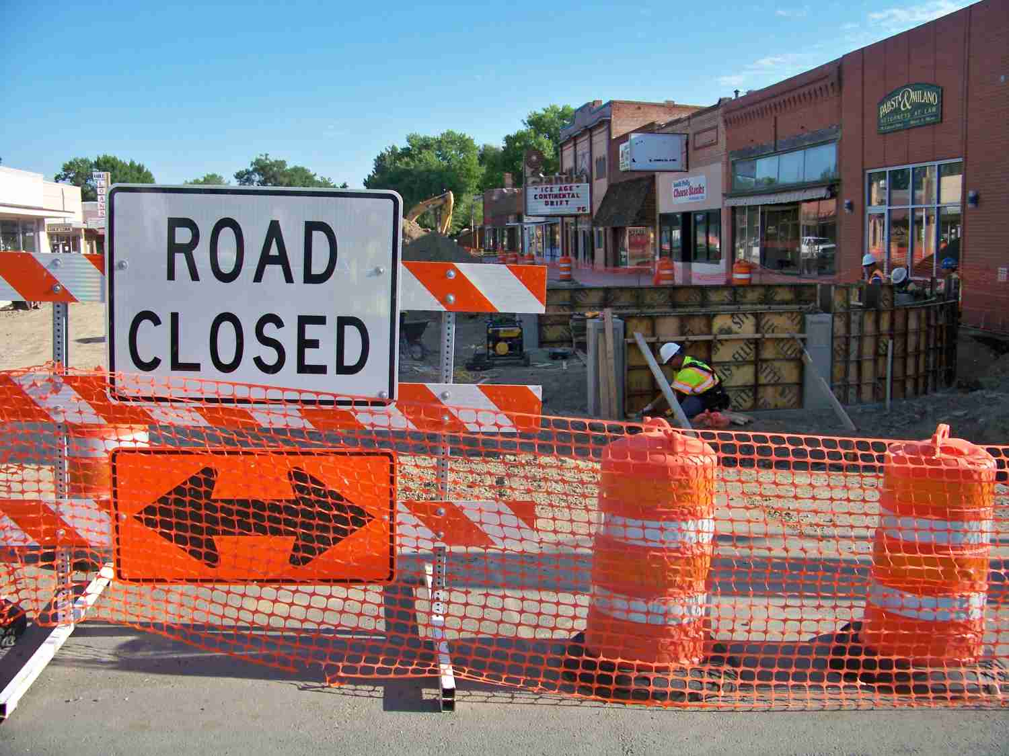
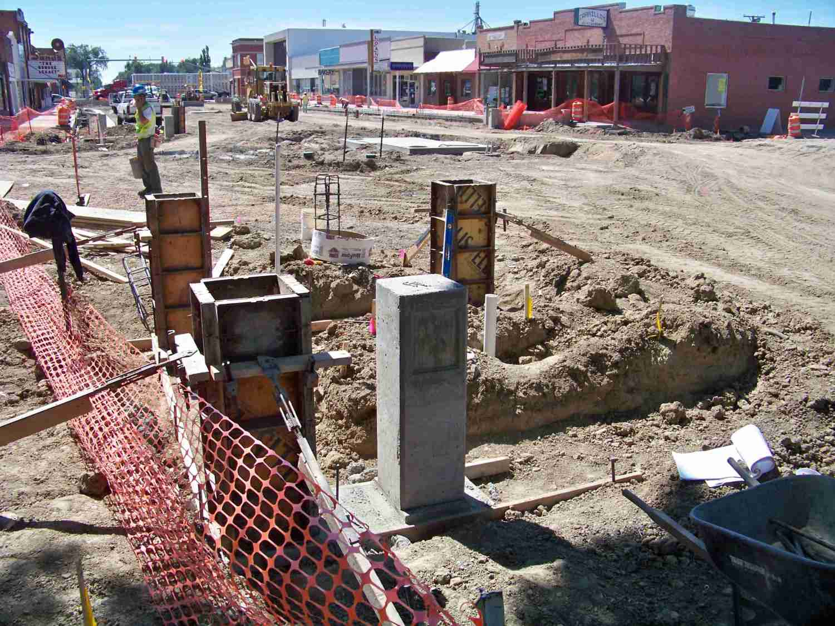
Downtown Improvements

Slide 8
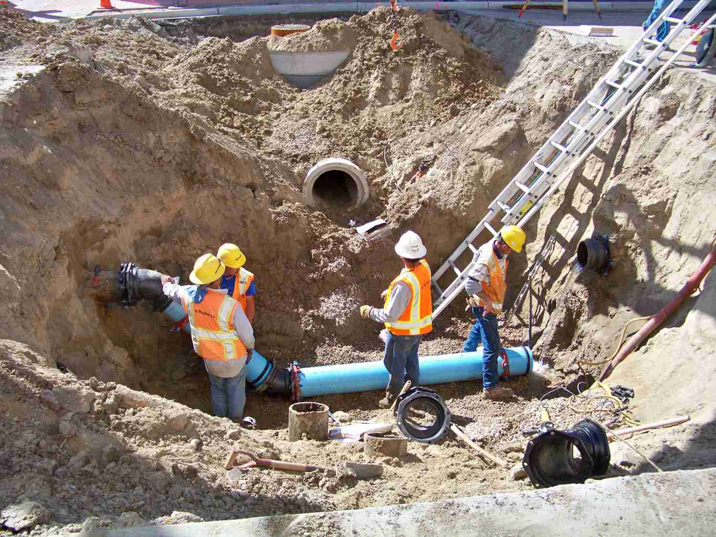
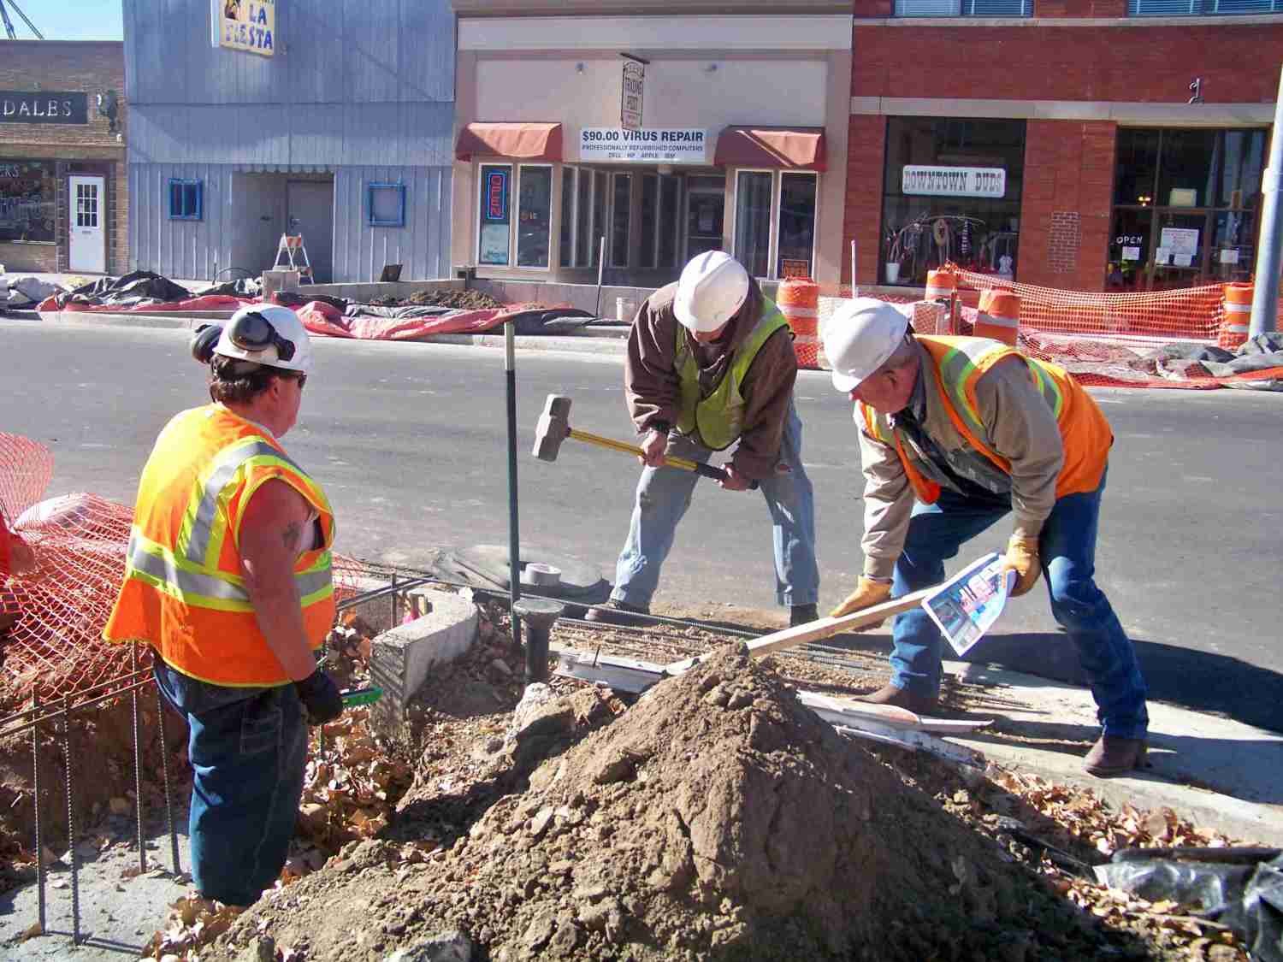
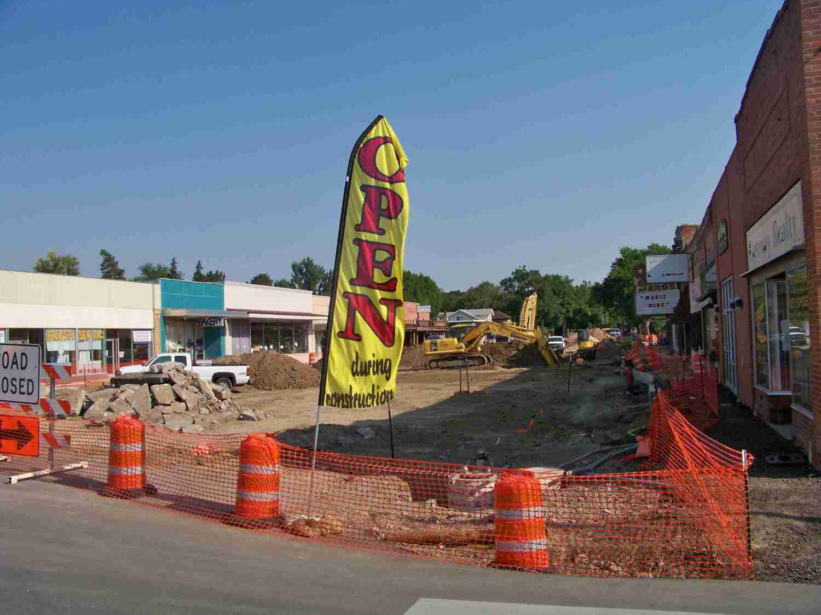
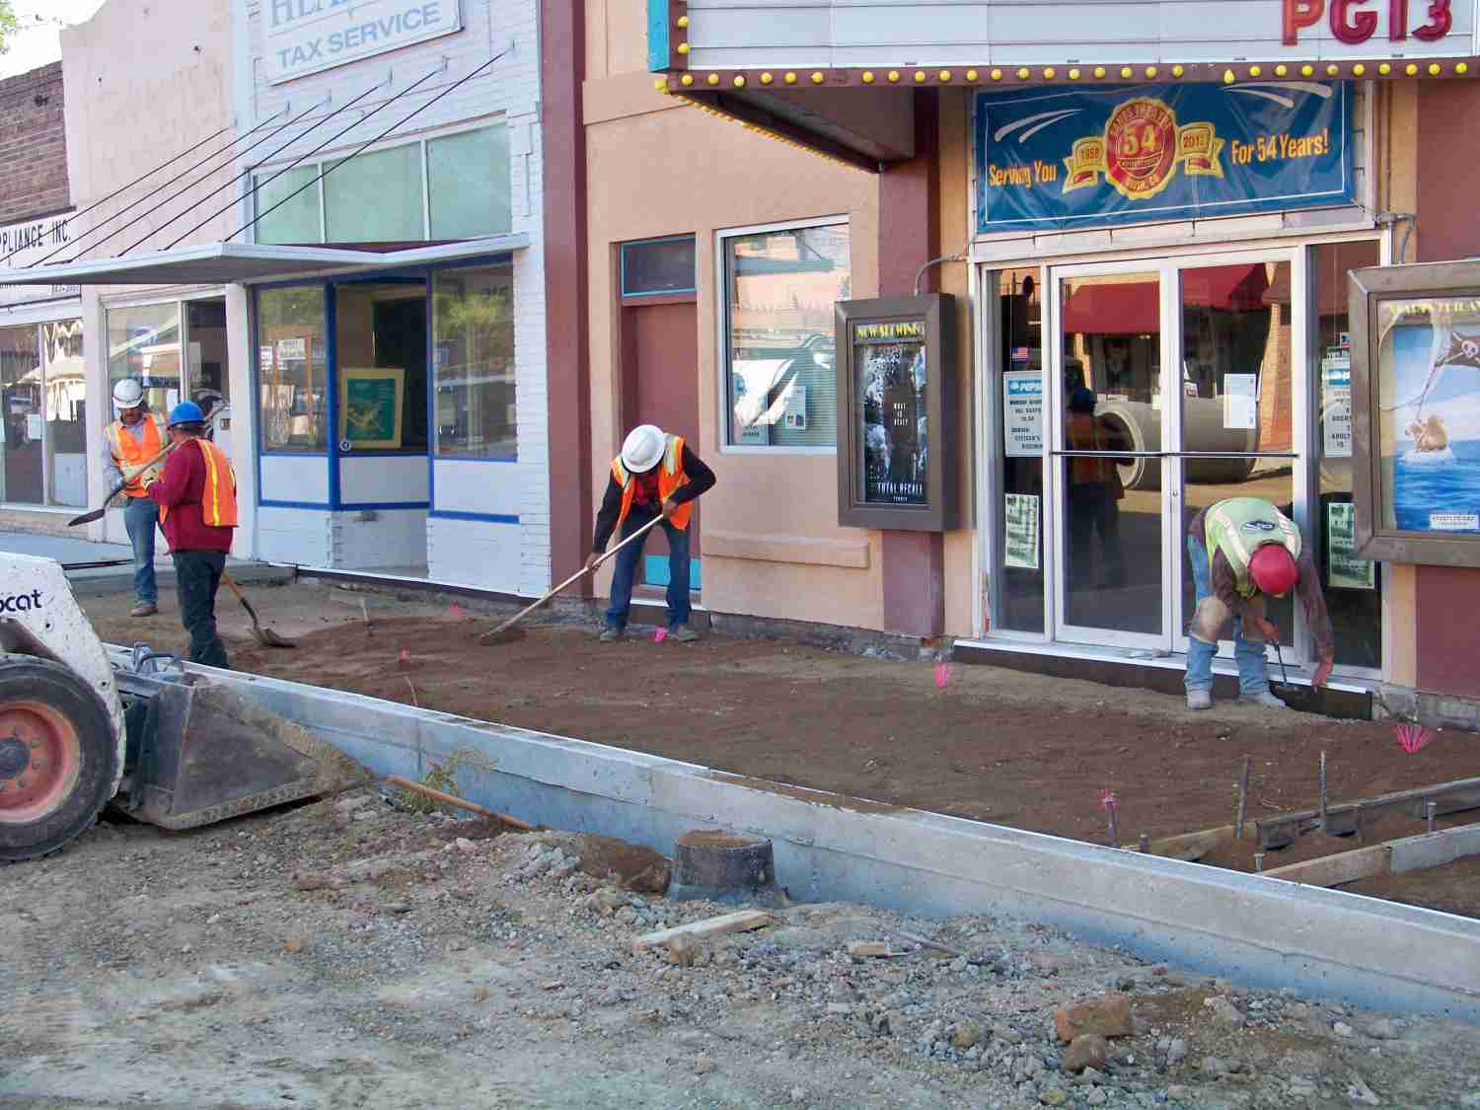
Downtown Improvements

Slide 9
Downtown Improvements
Wider and ADA compliant sidewalks (More Walkable)
Installation of benches and trash receptacles
Installation of bike racks to encourage bike riding as an alternate mode of transportation.
ADA crosswalks and ramps constructed.
Planting of trees and shrubs to present a more attractive and vibrant downtown. (Heart of Community)

Slide 10
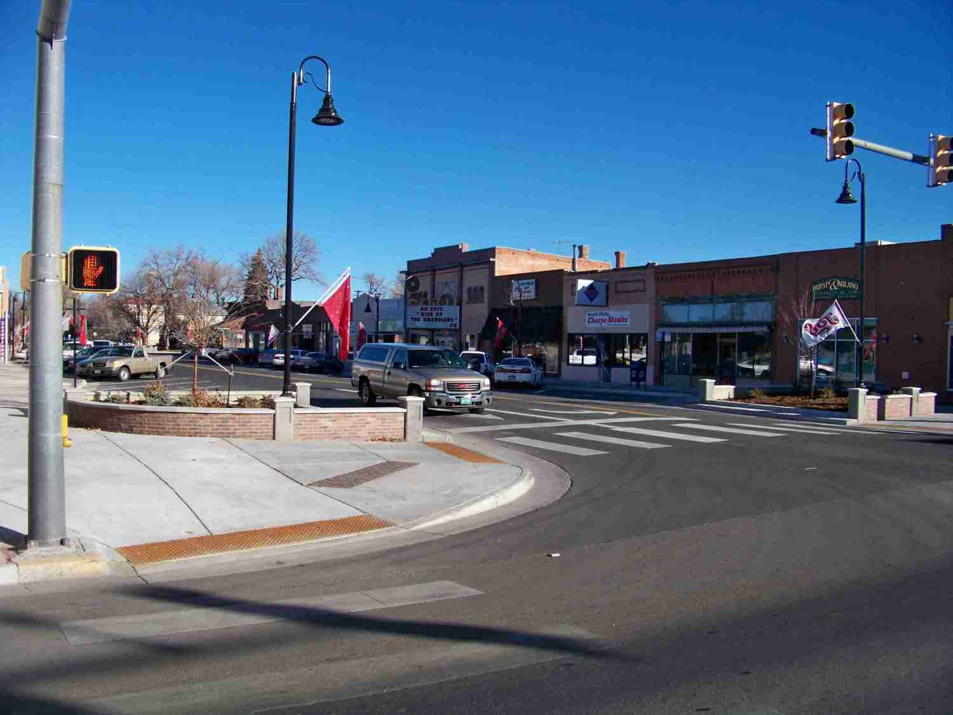
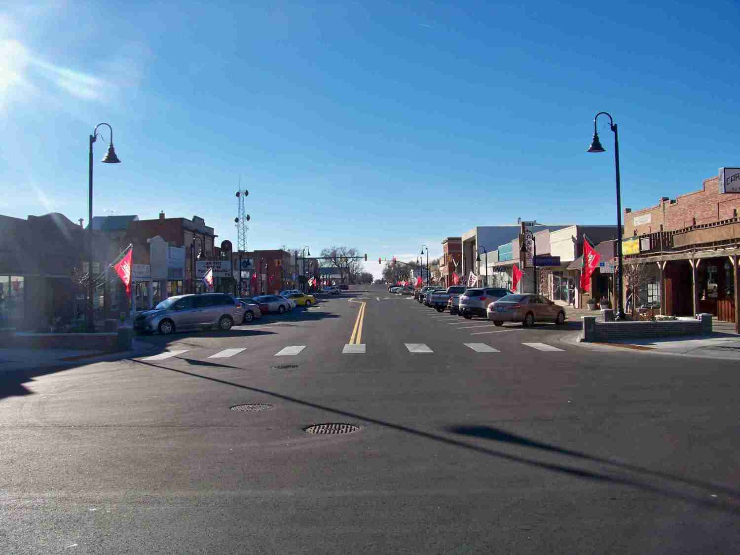
Downtown Improvements
Safe Parking and Lighting
Traffic Calming Features

Slide 11
Use Modification
Allowing Downtown Businesses or Properties the option of living spaces.
Upstairs or 50% of rear portion of the first level can be a living quarter (use by right)
Encourage walking and living downtown

Slide 12
Use Modification
Some challenges due to International Building Code requiring separation and fire walls between uses.
Access to some properties pose a challenge.
ADA accessibility can be challenging as well.
Risk is sometimes an undesirable use might open next door. For example a liquor establishment, pet shop, cigarette shop, etc.

Slide 13
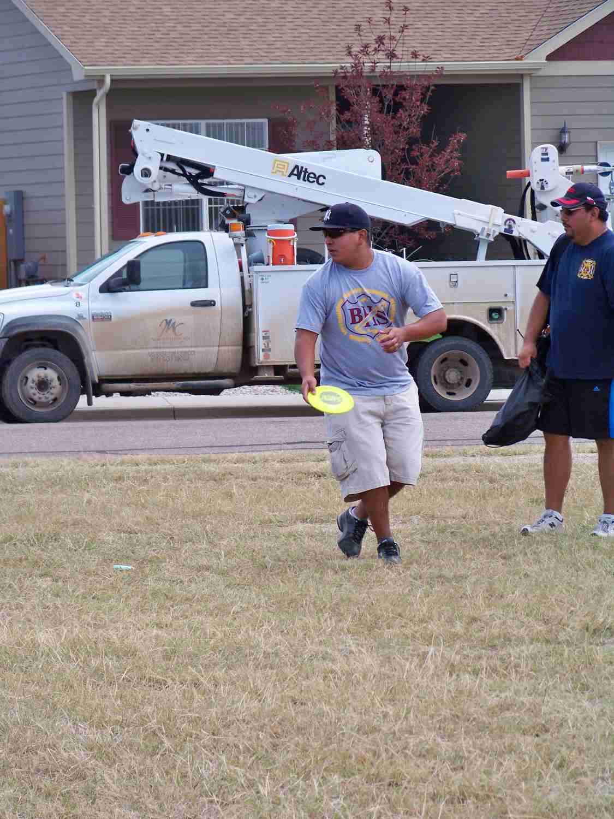
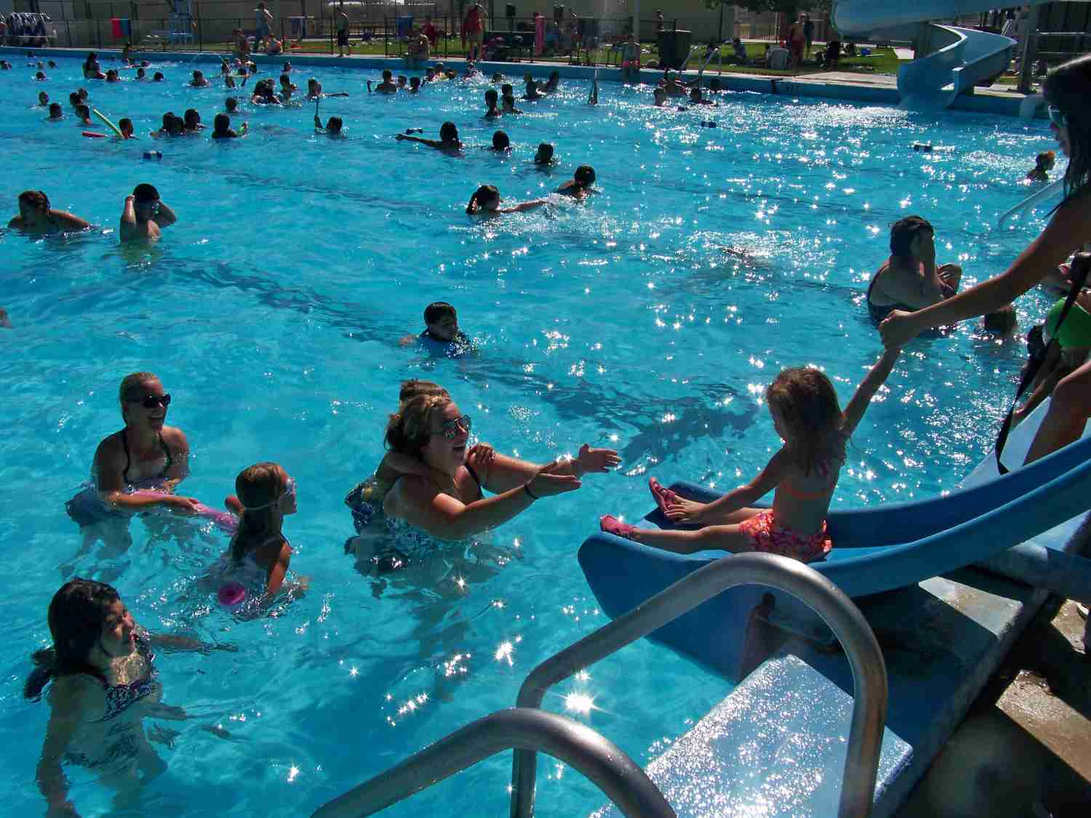
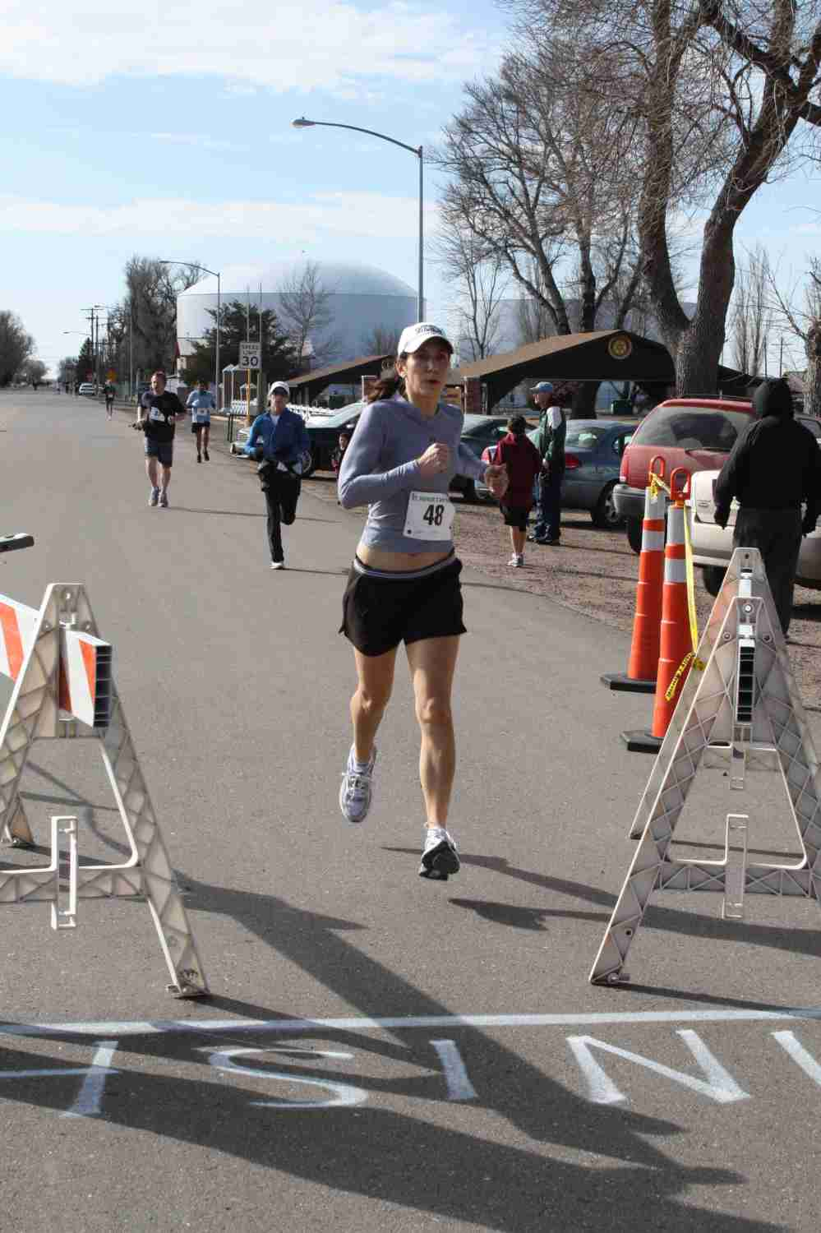
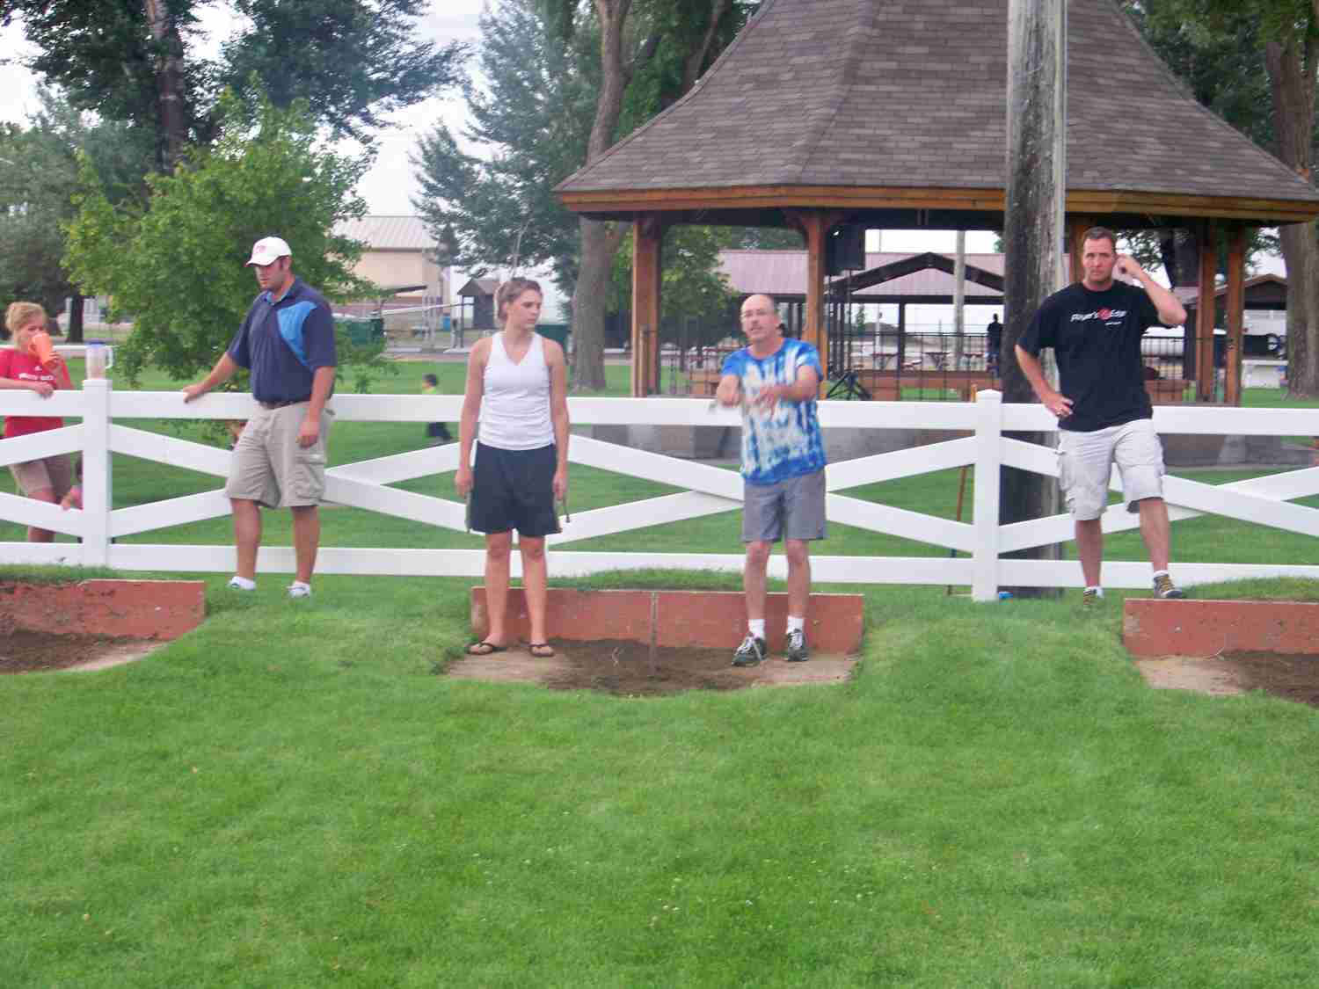
Healthy Activities

Slide 14
Healthy Activities
Well rounded recreational programs for a smaller community.
Shared use with the High School weight room.
5K races and walks
Skate Park construction and expansion
Disc Golf Course construction
Future interconnection with trail system to other communities
Bike path planning efforts

Slide 15
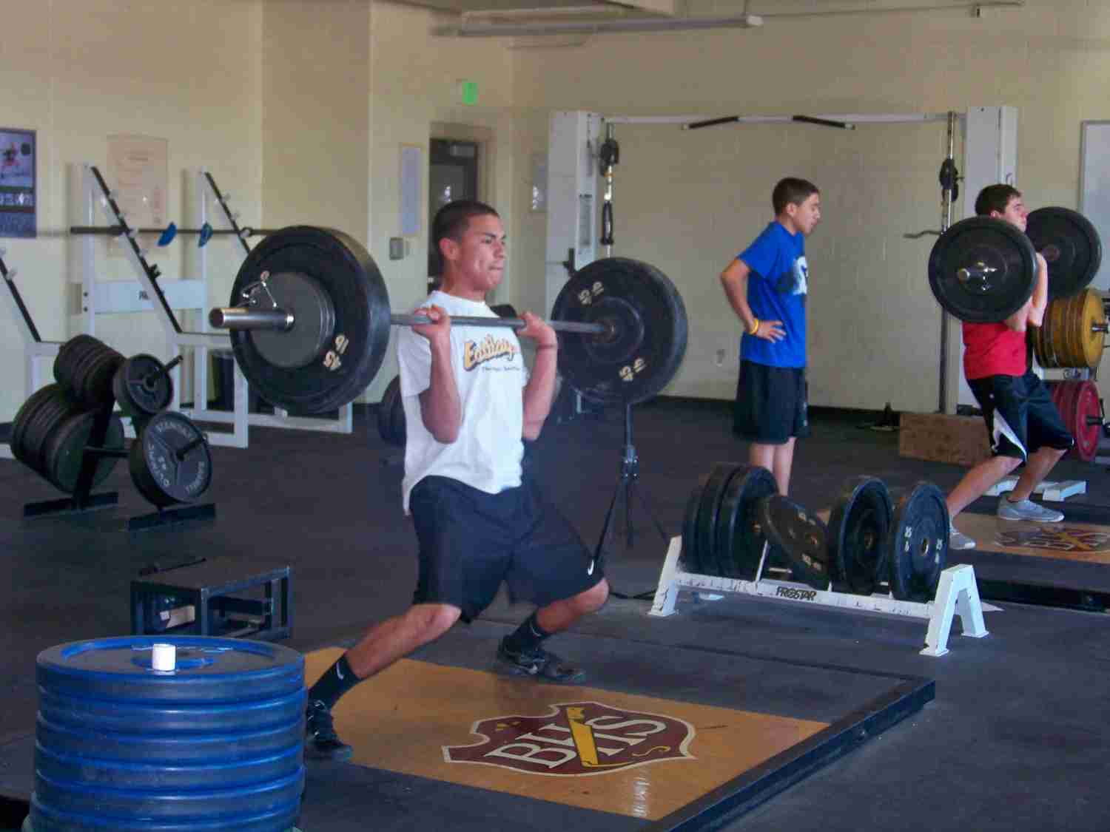
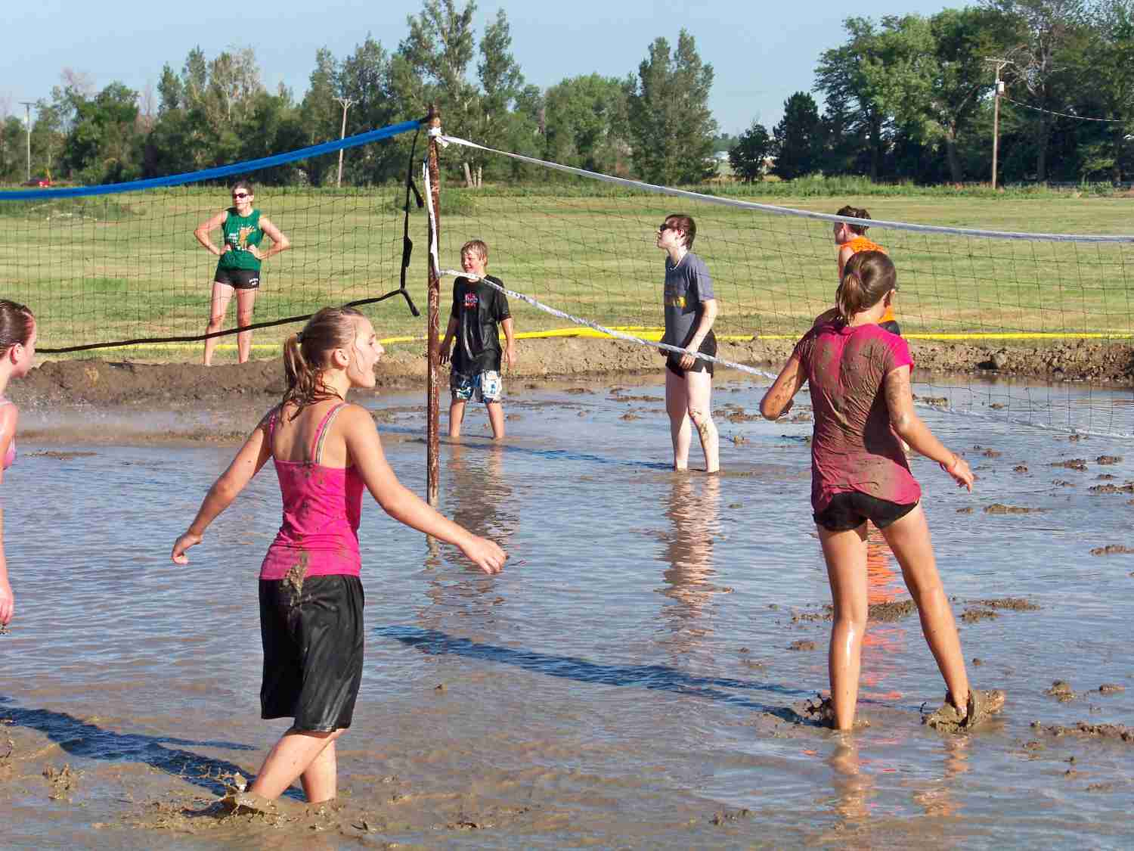
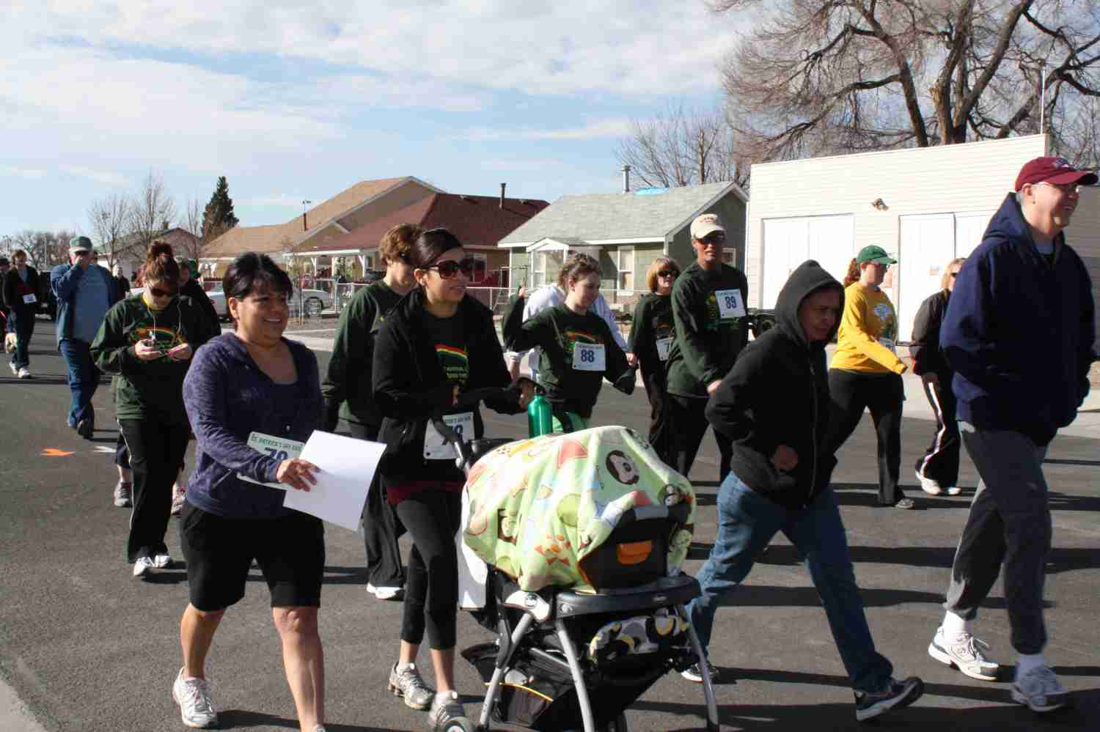
Healthy Activities

Slide 16
Healthy Activities/City Employees
Community Health Fair (EMCH/Banner Health)
Healthy Cooking Classes (EMCH/Banner Health)
Council Meetings healthy snacks and menus
Employee Health Flyers
Quarterly Fruit and Vegetable highlights for employees
TRIAD EAP
City Counsel approved Resolution No. 2013-6 Setting Forth the City of Brush’s Commitment to the Heal City & Towns Campaign—22 April 2013

Slide 17
Wheat Ridge – Ridge at 38
Retrofitting a “Main Street”
Placemaking to create economic development and attract strong households

Slide 18
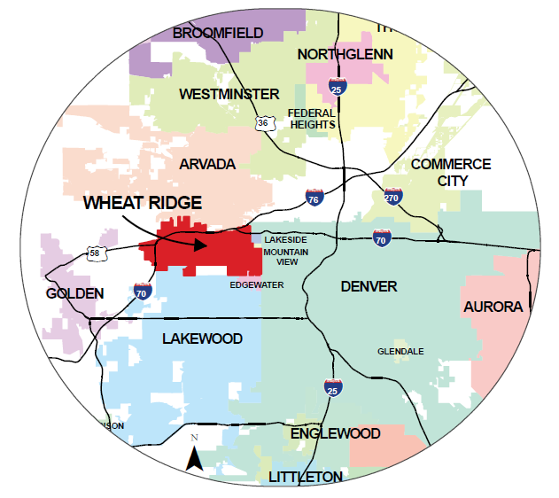
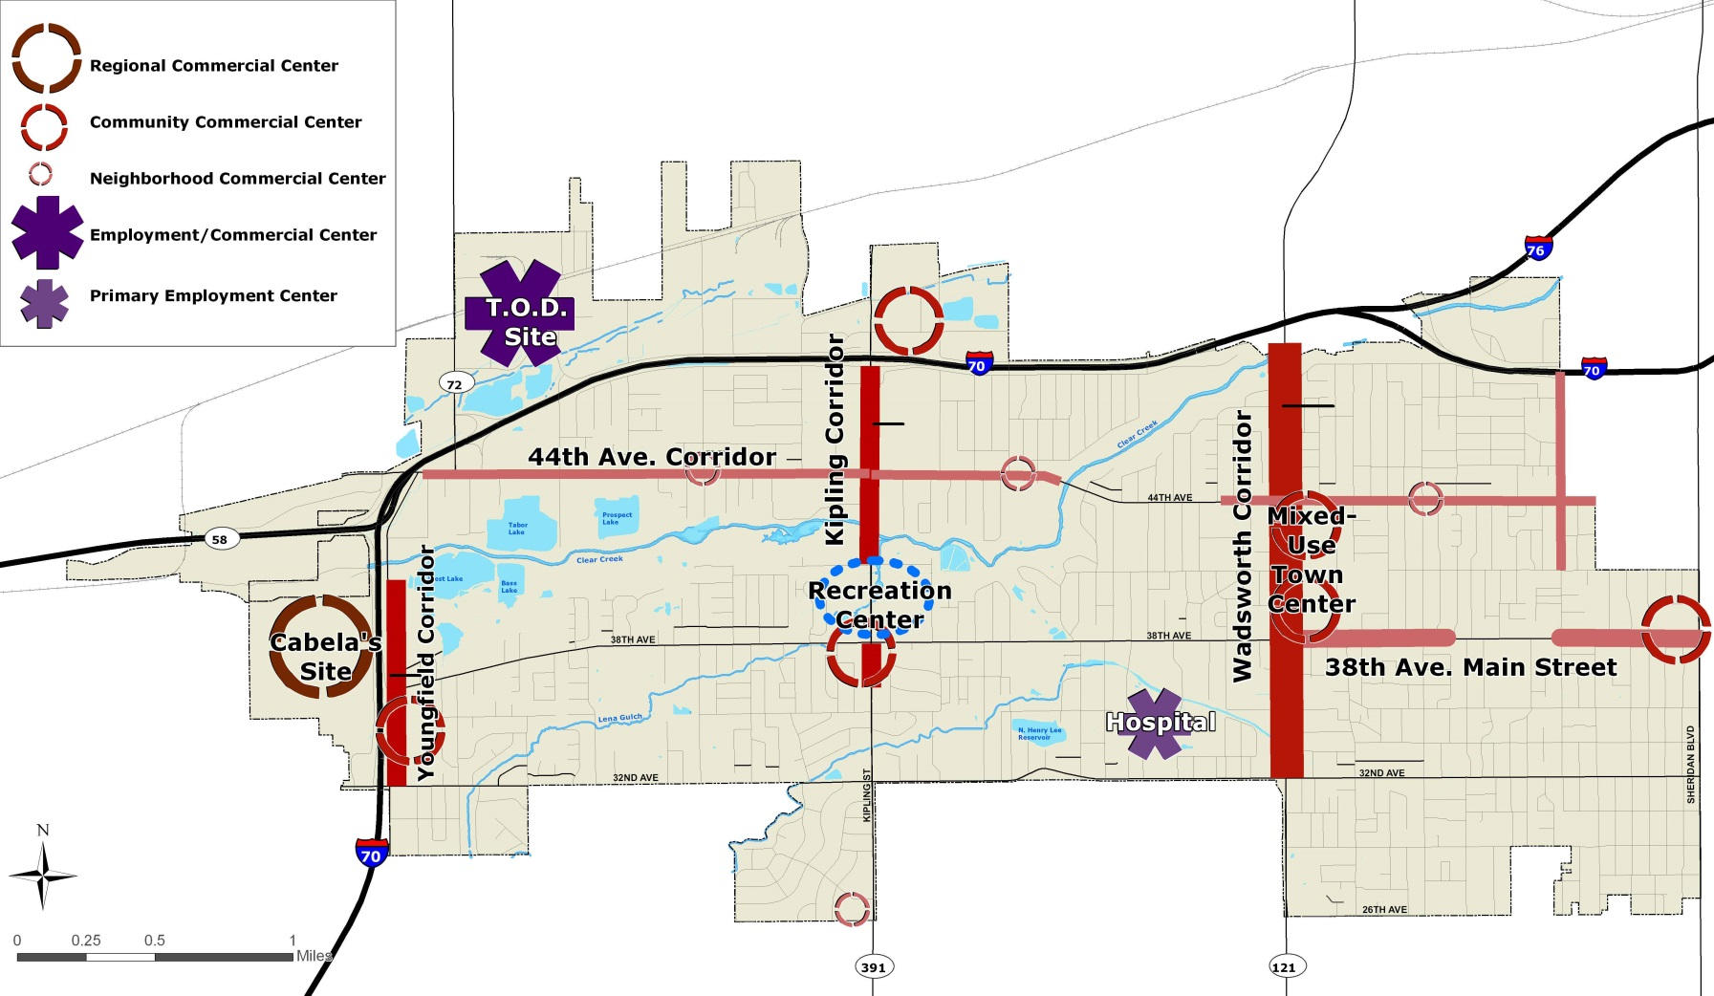
Regional Context

Slide 19
Wheat Ridge Context
Inner ring suburb on west side of Denver
Larger lot single family ranch homes
50s era commercial corridors both north-south and east-west
Great location!
In need of reinvestment and place making
Economic development a high priority

Slide 20
Planning/Policy Background
2005 Neighborhood Revitalization Strategy – corridor revitalization and attract strong households
2009 Comp Plan – 38th Avenue one of 5 high priority areas – “main street”
2011 38th Avenue Corridor Plan – multiple public input sessions – partnership with LiveWell Wheat Ridge

Slide 21
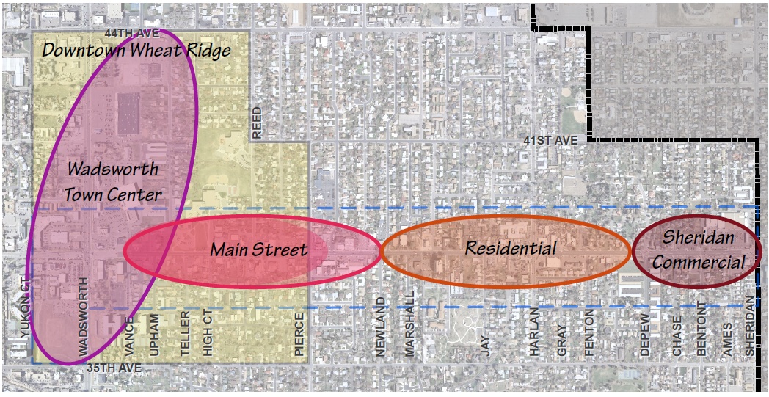
38th Avenue Corridor Plan

Slide 22
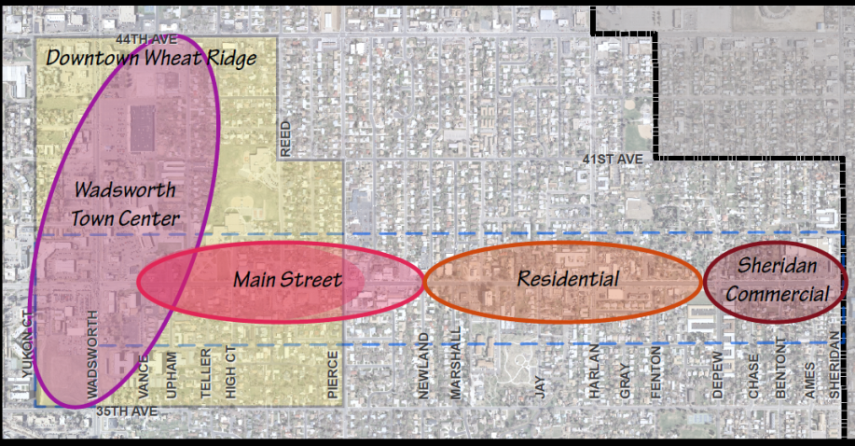
38th Avenue – Key Recommendations
“Road diet” in order to reduce vehicle lanes and add pedestrian amenities and create a more active and walkable City
Economic development
Identity – Marketing and Branding
Grass roots leadership
Events to activate

Slide 23
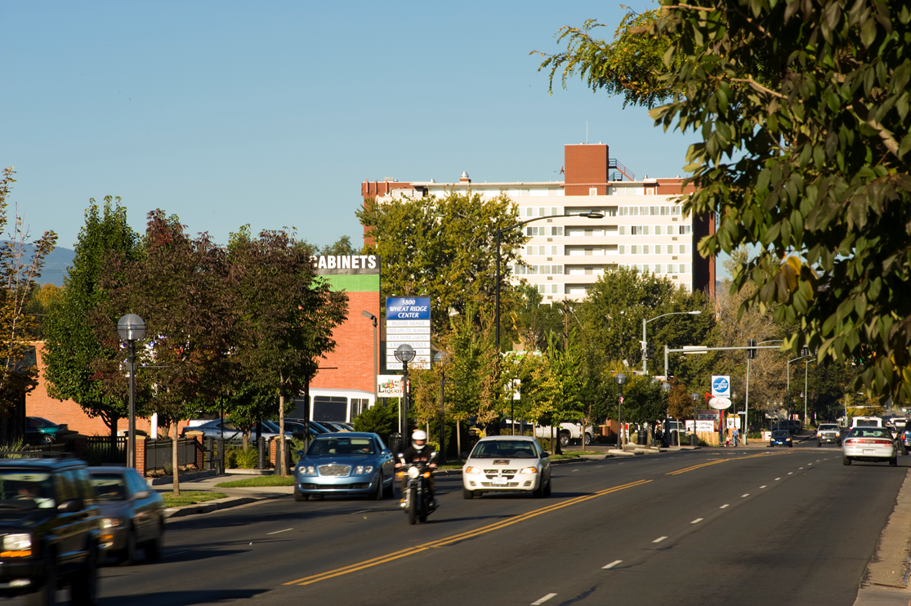
38th Avenue Corridor

Slide 24
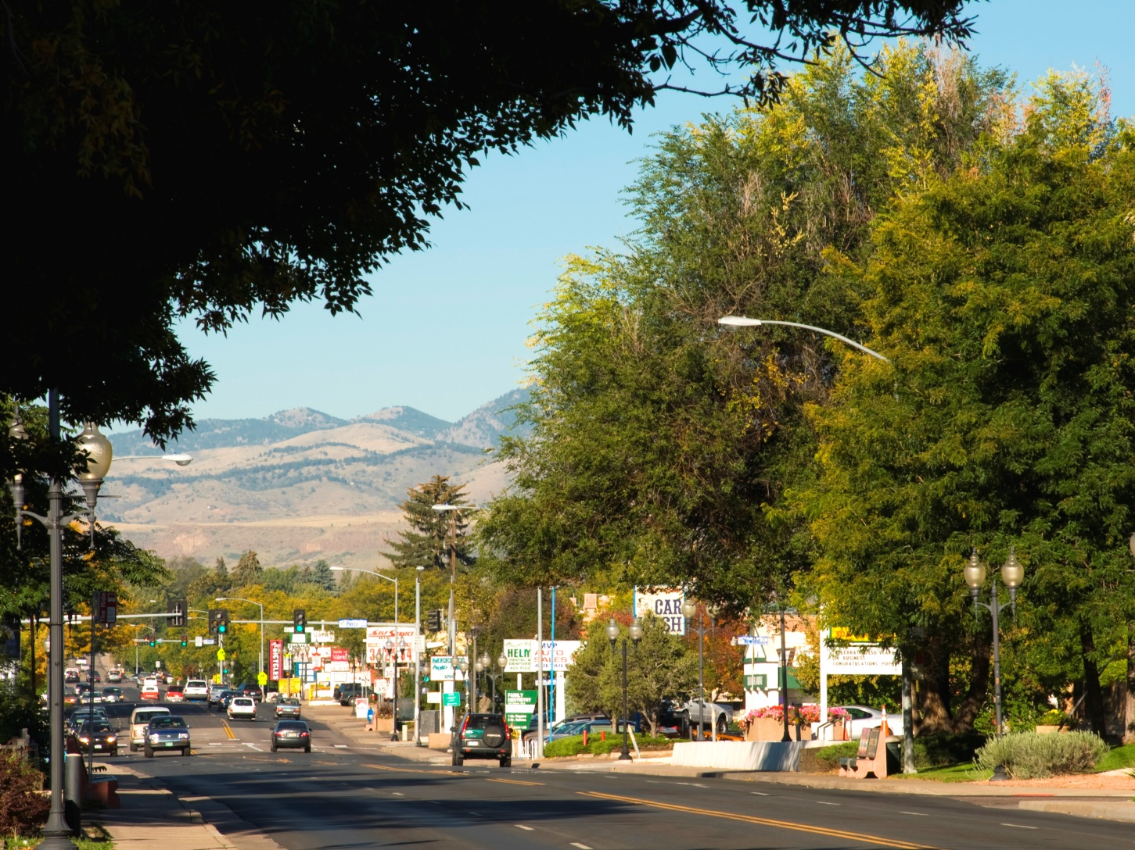
38th Avenue Corridor

Slide 25
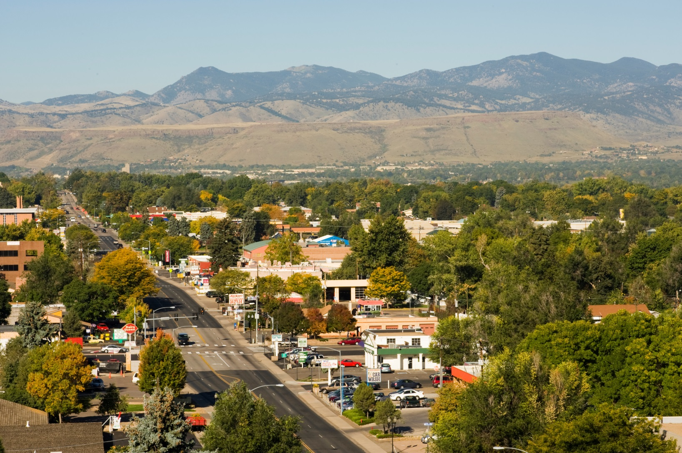
Looking West to the Foothills

Slide 26
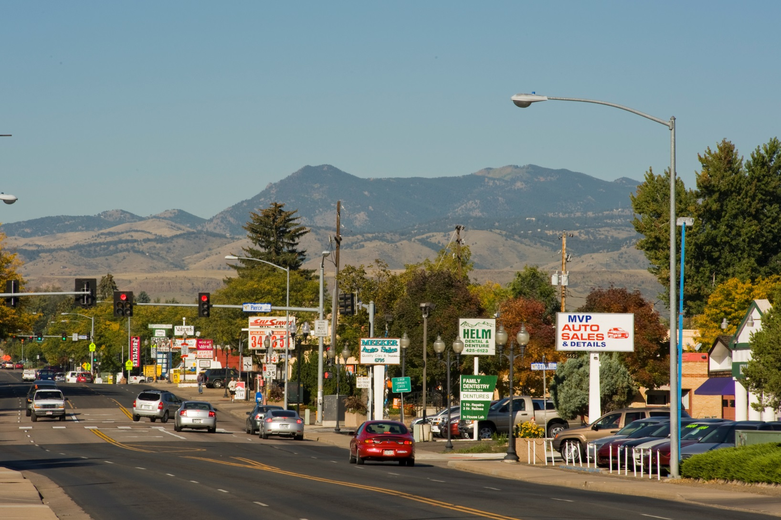
Typical Auto-Oriented Corridor

Slide 27

Key Successes
“Road diet” pilot project: restriping, back-in parking, planters and pop up cafes
28 new business in 2 years
Sales tax revenues are up – prelim data
Traffic functioning as predicted
Banner poles being installed
Two major events – more in
2013

Slide 28
Key Successes
Countless LiveLocal events, many focused on walking and biking
New urban ag regulations to make it easier to grow your own food – Market Garden just planted on 38th
Mixed Use zoning adopted allows for all uses – encourages walking
Notes:
This is a second slide for additional key successes, more focused on the mission of HEAL

Slide 29
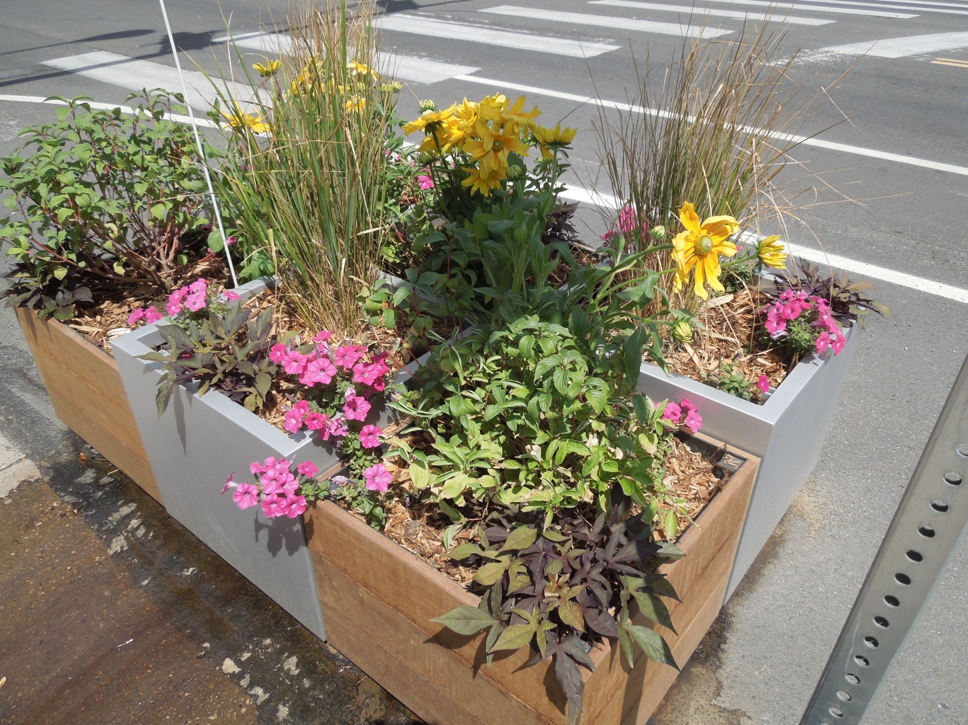
Temporary Street Planters

Slide 30
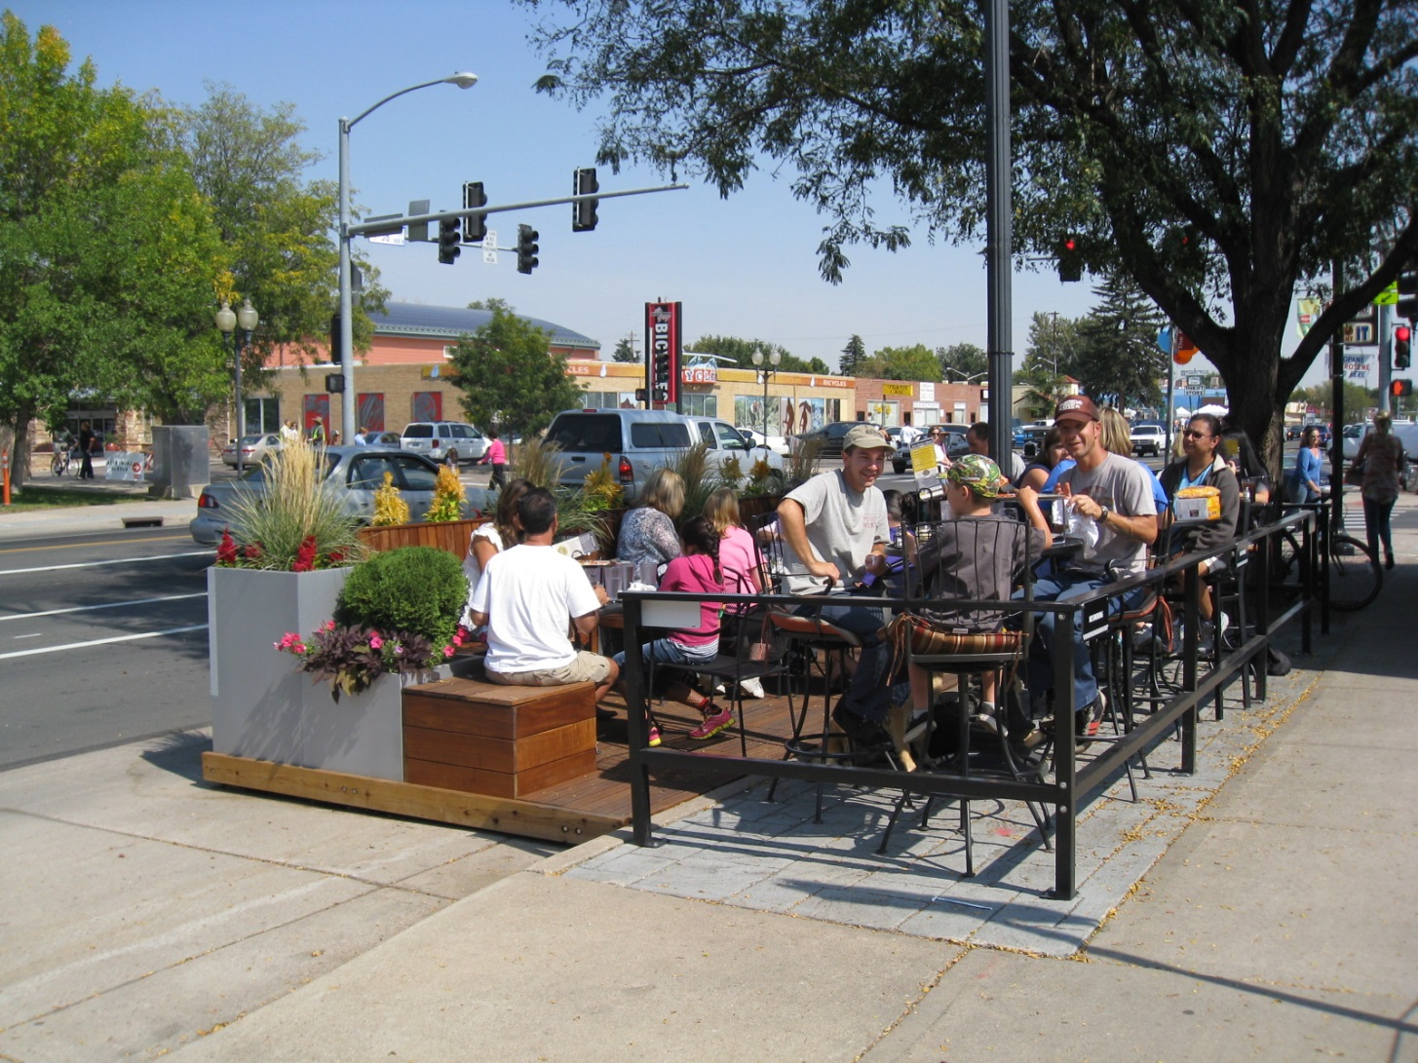
Temporary “Pop up cafes”

Slide 31
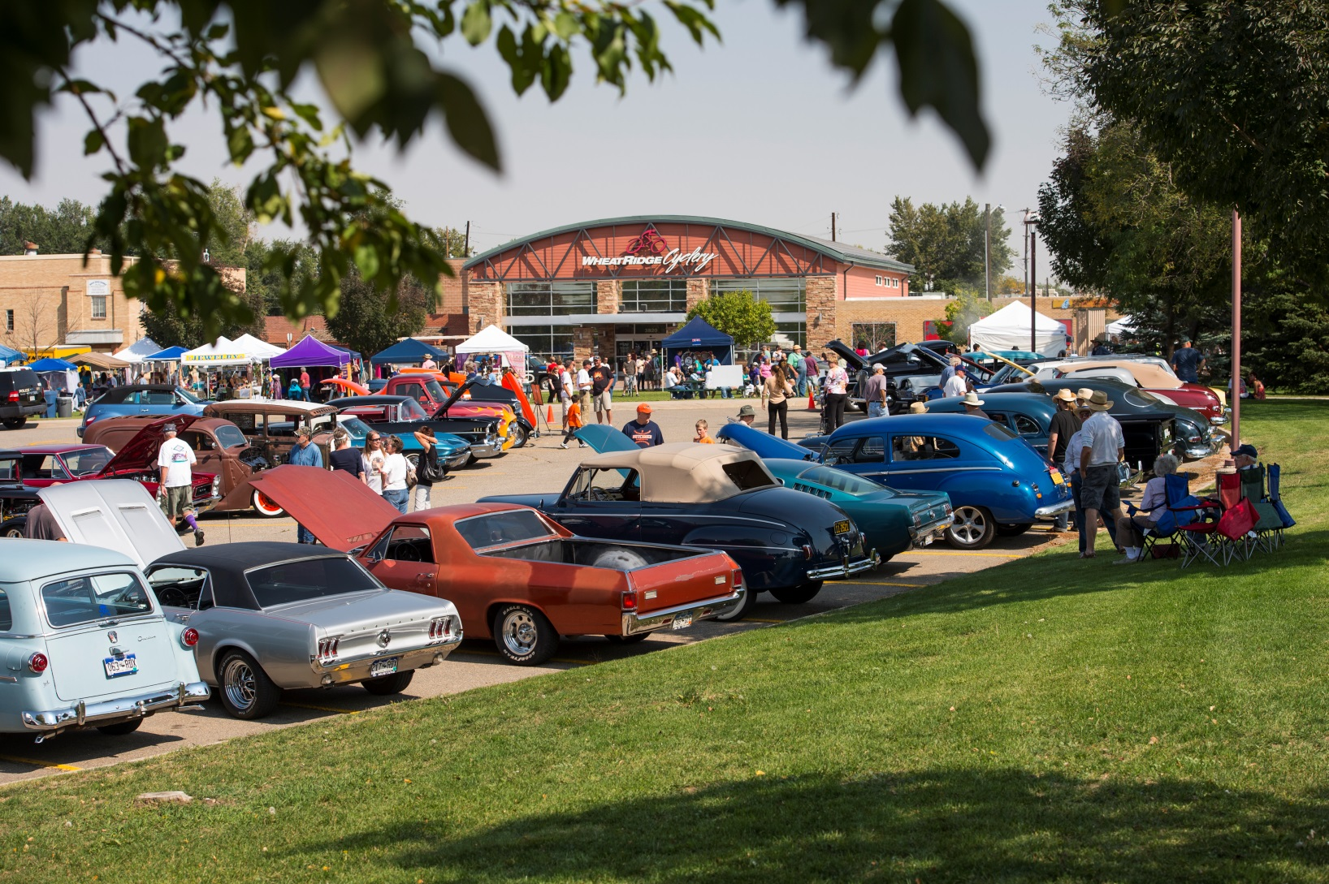
Ridge at 38 Celebration

Slide 32
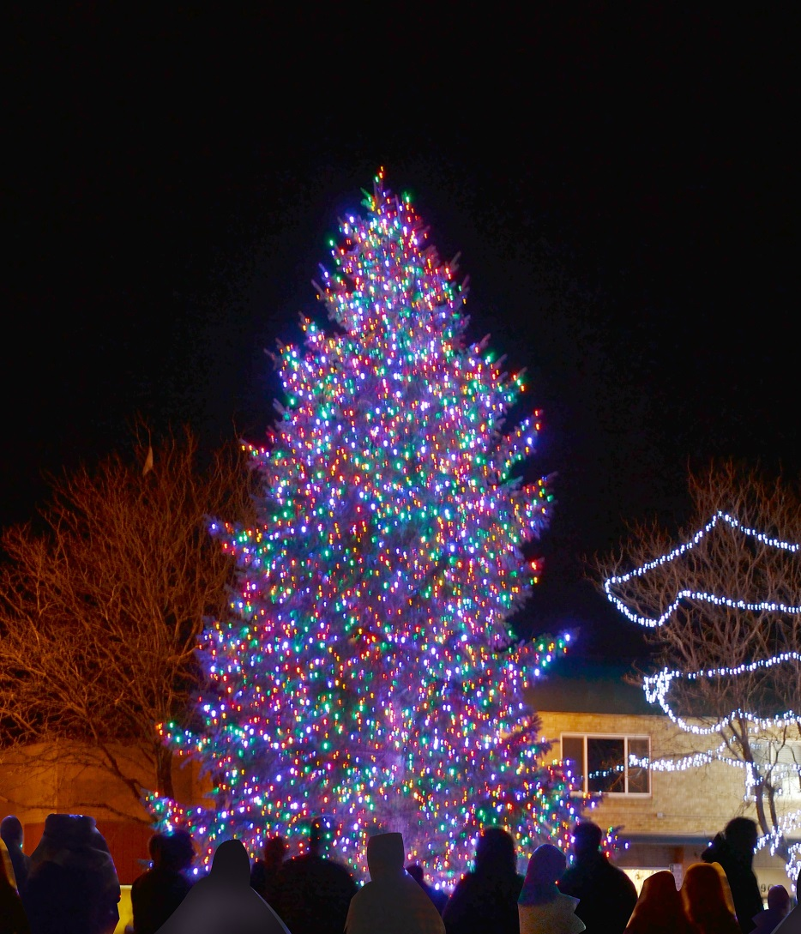
Ridge at 38 Holiday Festival

Slide 33
Next Steps
Design process for permanent streetscape
Traffic still a concern for some…
Monitoring increases in bike/ped activity
Continued private investment
  Two housing projects in review and 2 restaurants/pubs to open soon
Implement permanent streetscape design
Consider incorporating a civic component
Aggressively market the new brand
Formalize business district

Slide 34
LWWR Overview
LiveWell Wheat Ridge (LWWR) is one of 24 Colorado communities funded by LiveWell Colorado working to reduce and prevent childhood and adult obesity.
Since 2005, LiveWell Wheat Ridge has been a multi-sector partnership of community stakeholders working to create an environment and culture which supports healthy eating and active living (HEAL) to reduce the impact of obesity in Wheat Ridge.
We accomplish this through supporting Wheat Ridge programs, policies and changes to the physical environment and community infrastructure.
Jefferson County Public Health serves at the lead and fiscal agency for LWWR.

Slide 35


Multi-Disciplinary Partnerships
WR Residents
Exempla Lutheran Medical Center
Kaiser Wheat Ridge
The City of Wheat Ridge
Local Businesses
Bicycle Colorado
Wheat Ridge Police Department
Jeffco Public Schools
Wheat Ridge 2020
CSU Extension
Faith Communities
Notes:
Molly, here I’m going to list and briefly touch on the wide range of entities, including the city, that we have partnered with to one degree or another across our varied initiatives over the years, with a brief focus on partnerships central to Corridor Plan development and adoption.

Slide 36
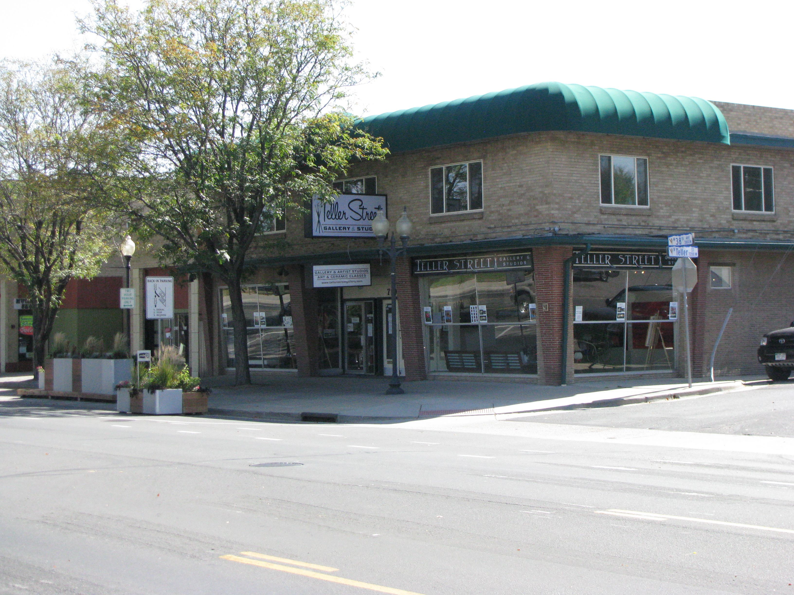
LWWR and the Corridor Plan
Funded 3 community input sessions
Staff / Consultant team
Ongoing education and encouragement of coalition
Stakeholder committee
Comment on all drafts
Public support during council hearings
Notes:
Molly, with this slide, I’ll focus on LWWR’s role and involvement specific to the project, starting with LWWR’s funding of the community input sessions and ending with public testimony before Council in support of adoption in October 2011. Also, I’ll make mention of Teller Street Gallery (see photo) as one of 32 new businesses that have opened within the study area since the start of 2011 and site of May’s Live Local community building event.

Slide 37
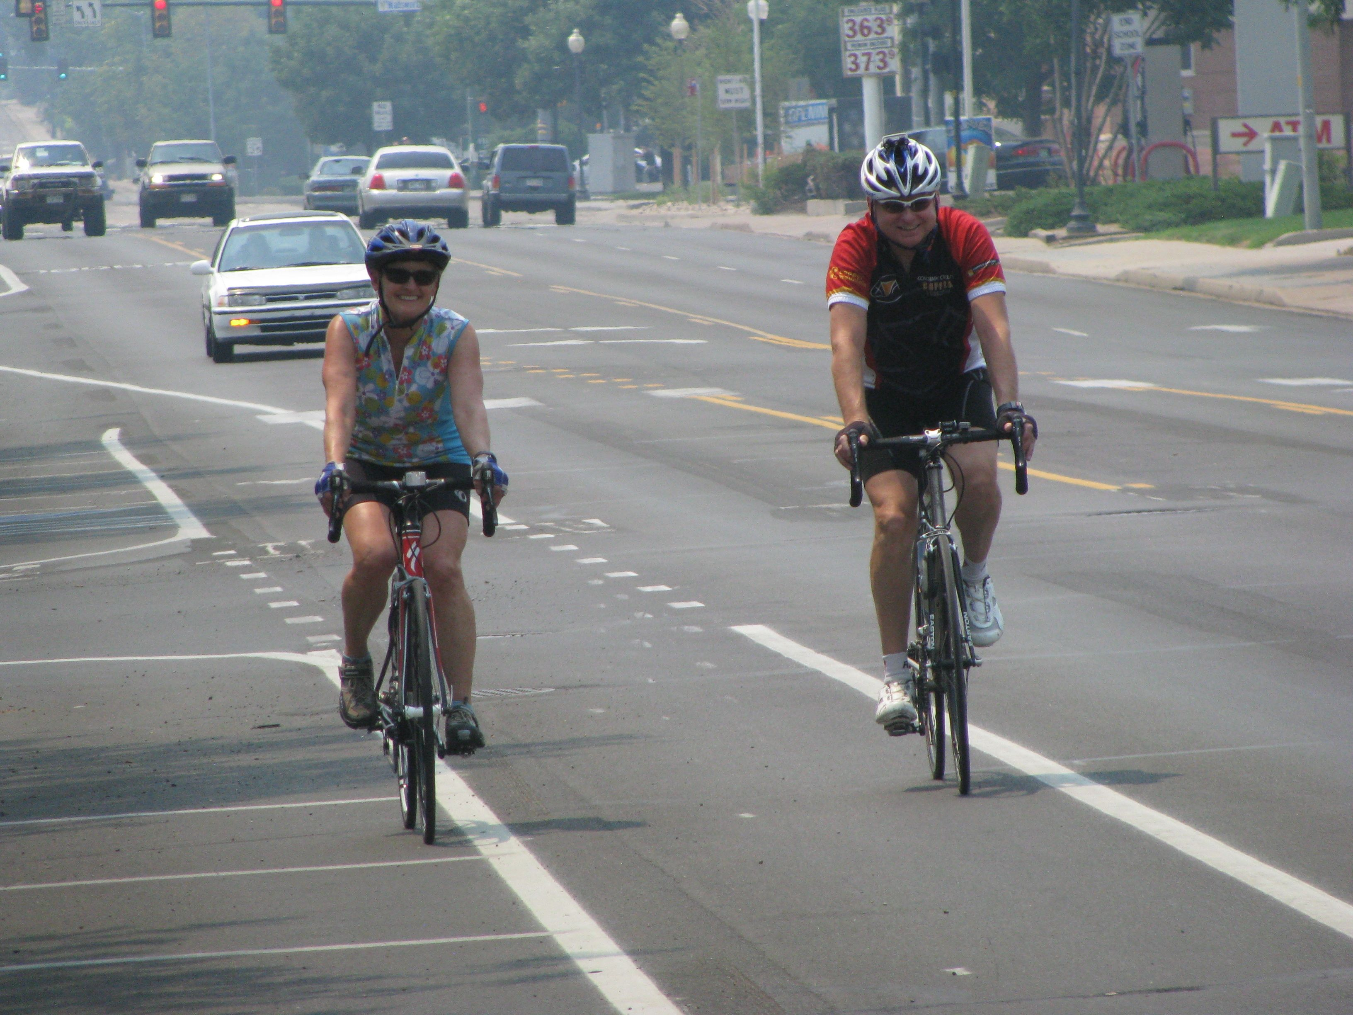
Active Living - Built Environment
Enhanced bicycle and pedestrian facilities on the corridor.
Improved bicycle and pedestrian connectivity to / from surrounding neighborhoods.
Maintain access to bus transit.
Notes:
On this slide, I’m going to drill down a bit and touch on some of the specific comments we made through through reviewing draft(s) of the Plan with the intent / focus of our comments being creation and placement of infrastructure (built environment features) to ‘make the healthy choice the easy choice.’ Because where you live affects how you live, our comments were intended to help guide long-term development and design that would foster more walking and biking for all ages and abilities for commuting, errands / outings, and / or physical exercise. I’ll also mention that WR Middle School is on the corridor and this use warrants enhanced bicycle / pedestrian safety and access. Shown in photo is the on-street bike lane on 38th. If time permits, I’ll share the quick story of how coalition members worked with public works at one of the project open houses and identified room within the ROW (at the midnight hour) to include the lanes.

Slide 38
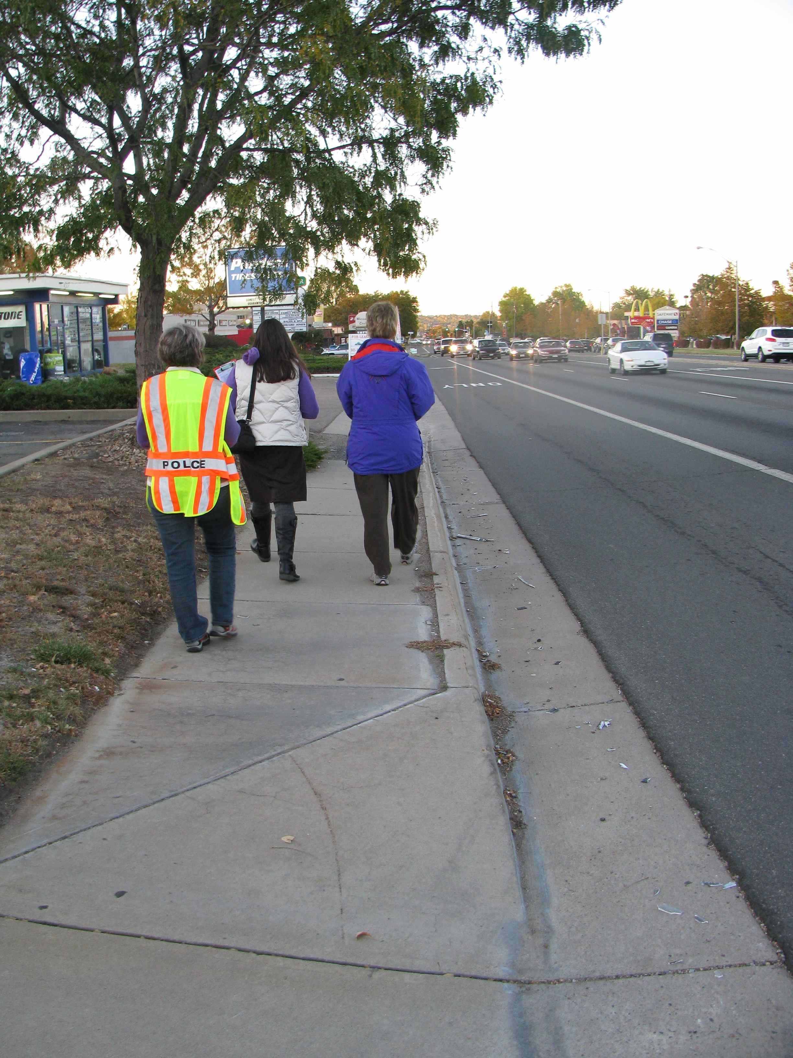
Since Adoption
Staff committee
Leadership committee
Two walking audits
Harvest exchange
Mile on the Ridge
Bike corral contest
38th Avenue endorsement letter
Notes:
With this slide, I’ll walk through some points of LWWR involvement since adoption in October 2011. Part of the message I’ll touch on is that the first 18-24 months was identified as a ‘trial period’ and that (LWWR feels) community education and involvement, and ongoing promotion is critical during this phase. The photo is from one of the walking audits on the west side of Wadsworth near 38th (at the west end of the study area).

Slide 39
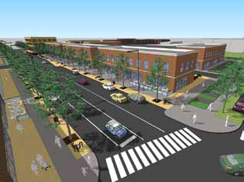
Lessons Learned
Partnerships are key - break down the silos.
Messaging. Healthy Design = Economic, Environmental, Social Benefits.
Give it time
  Allow for wrinkles
  Celebrate and highlight successes
Source: City of Wheat Ridge
Notes:
This one is fairly self-explanatory, but let me know if you would like any specifics on intent.

Slide 40
Questions?

