Slide 1
CML’s 95th Annual Conference June 20 – 23, 2017 Breckenridge

Slide 2
We Dream Big and Deliver
Marc Williams, Mayor;
Mark Deven, City Manager;
Linda Haley, Human Resources Director

Slide 3
Setting strategic direction
Intentional decision to become a customer focused and results driven organization
Identified the need to establish 100% alignment between the City Council and staff
Develop a system of accountability by using performance measures tied directly to the City Council Strategic Plan (The Golden Thread)
Establish the framework to support our employees in the execution of the work
Notes:
Mark Deven to introduce and set stage. Marc Williams will add comments

Slide 4
The Business Case for Change
The City of Arvada’s Organizational Development initiative is a deliberately planned, organization-wide effort to sustain our greatness as a high performing, results oriented and customer focused organization. It involves establishing a framework of visionary leadership, strong business strategy, sound structures and systems and great people. It requires an investment (and reinvestment) in this framework to continuously improve and achieve performance excellence.
Notes:
Mark to hand off to Linda. Linda to discuss details of OD initiative
assessment
need for change

Slide 5
8 Key Areas
Strategic Direction - Vision/Mission/Values
Aligned and High Performing Leadership
Strategic Learning Organization
Integrated Performance Management System
Customer Focus – Internal and External
Effective Communication Processes
Collaborative, team-based Culture
Diversity and Inclusion
Notes:
Linda to discuss
Based on organizational assessments – all in alignment with LT, MMT, Supervisors and Employees
Large numbers of employees provided input – get statistics from LT, MMT and employee assessments -
With goal in mind – high performance, proven results, improved services, engaged employees
Visual GRAPH of the 8 areas
1st Key area of the 8 – VMV…..these are in no particular order, however the first and most important piece of development, what sets the foundational core for our culture, is the VMV, so this is exactly where we started.

Slide 6
Employee Involvement
Committees and Roles
Numbers of employees
Percentage of workforce involved
All departments represented
All employee feedback and assessments
Notes:
Linda
Shining Stars – true admiration for these people, their dedication, their creativity, their commitment
Project Team
Steering Committee
Culture Design Committee
EPM Committee
Employee Committee
Communications Sub-Committee
Almost 80 employees involved in one way or another– over 10% of our workforce. 670 employees/80 = about 10 – 11% of our workforce
The assessments – all of LT, majority of MMT, in feedback groups and one on one meetings. Employee body received survey – Google survey – employees and front line supervisors. 370 of 620 responded – about 60% response rate. Asked specific questions relating to the identified eight development areas from LT/MMT interviews and focus groups. Looked for alignment and verification.

Slide 7
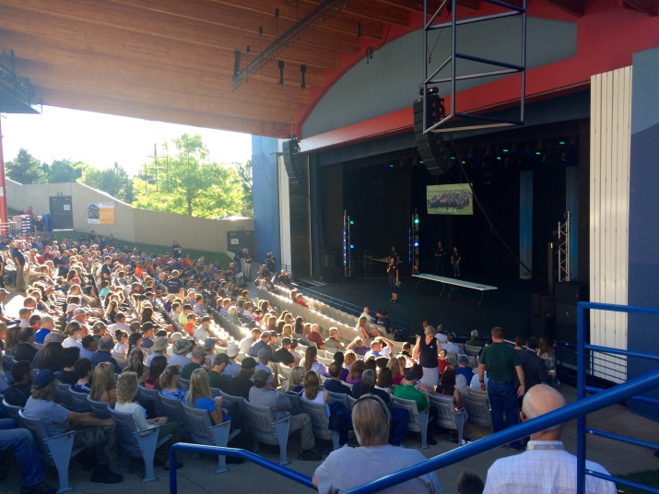
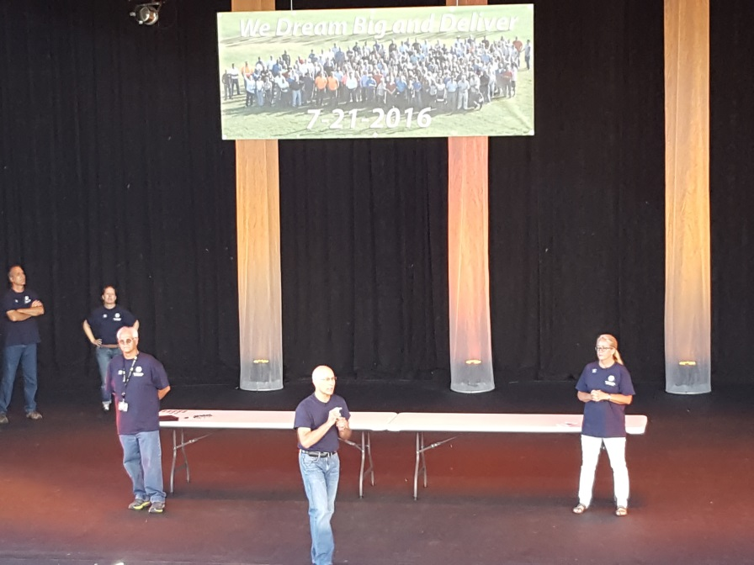
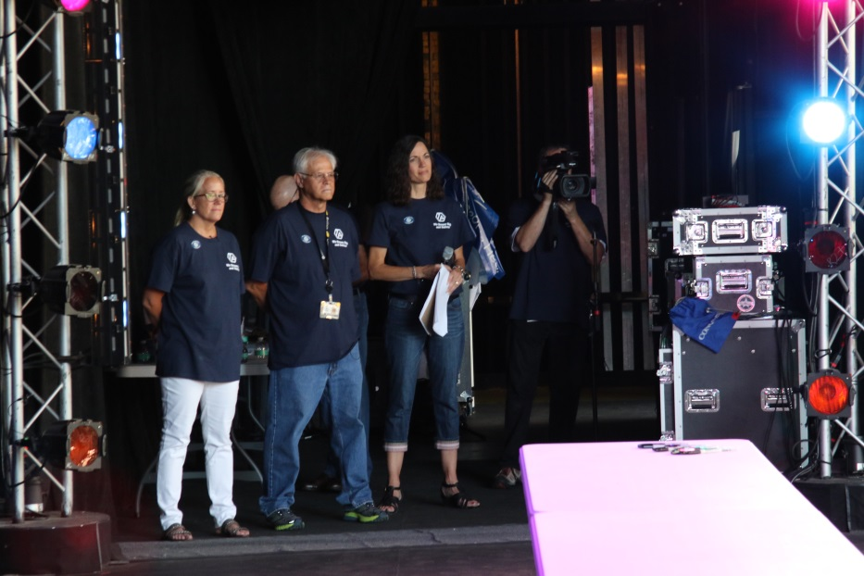
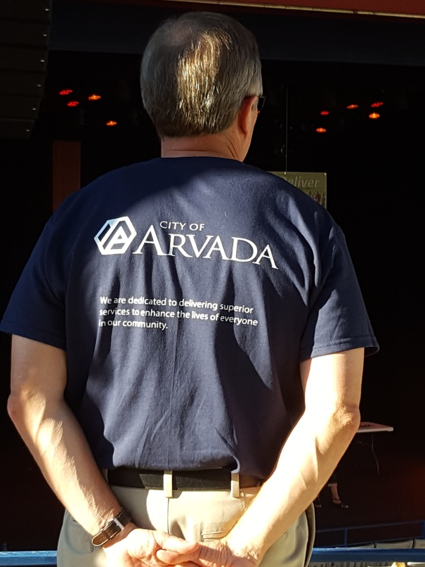
Vision
We Dream Big and Deliver
Notes:
Mark and Linda to take the next three slides - VMV
with Marc to add color
Excited to introduce to you our new Vision, Mission, Values
Here are some pictures from our Launch. I’ll mention some highlights in a minute.
Regarding the creation of the VMV – these were developed by our employees. These come from our employees – input from every department and every level of the organization. We have many employees feeling great pride in being a part of the creation of these. Can’t tell you enough how impressed I am with the amazing people who work here. Going through this process over the past year has highlighted the caliber, creativity and dedication of our employees – have incredible people who care deeply about Arvada – so powerful to see.
Provide the new VMV – bring wallet cards for City Council.
Discuss development, meaning, stories, etc,
Discuss Launch – celebration and new beginning – the emphasis on building more excellence, improving our organization to be successful and sustainable for years to come

Slide 8
Mission
We are dedicated to delivering superior services to enhance the lives of everyone in our community
Notes:
Carrie, is it possible to add the video clip of the mayor reciting the mission statement during the VMV launch?

Slide 9
Values
Innovation – We excel in creativity, flexibility and the use of best practices while valuing diverse backgrounds, ideas and perspectives
Passion – We are a high performing, inclusive team inspiring each other to pursue excellence
Opportunity – We value our diversity, embrace possibilities, face challenges, persevere and take action to deliver quality results
Notes:
EPM - defines the behaviors that support the Values

Slide 10
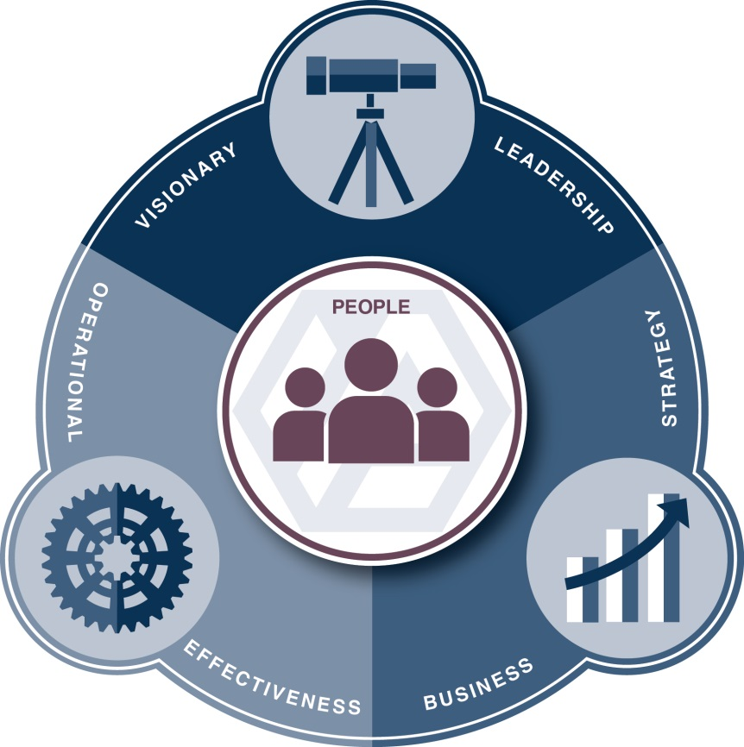
Why is this important?
Pursuing Excellence – The Arvada Way
Notes:
Linda
This is what it’s all about. *Provide handout of the OD graphic and take them through the interactive piece. – Just highlight the Visionary Leadership example…
Business Case with key examples
A visual description to show you what we mean
(Discuss Business Case and provide OD graphic w/ interactive piece)
The City of Arvada is a great organization, a top workplace, and a well run City. We also have opportunities where we can improve, and we know we are not immune to change. If we don’t set our sights on the goal and deliberately plan, as a whole organization, to address change and the continuous improvement needed to sustain our greatness, we could lose it.
drivers of the OD initiative - new leadership with Mark's vision - FOCUS, the fact our organization is losing over 30% of our organization due to retirements in the next few years - need to create a culture that will attract and keep new talent while creating internal systems and structures that will help capture institutional knowledge and improve current processes.
The City is undergoing a cultural transformation, led by a project team made up of CMO and HR management staff, and consultants. For over a year the team has been working on developing the foundation for organizational development at the City on a scale that has never been done before. A comprehensive assessment of the City’s current culture was conducted and results were compared with the framework of the Malcom Baldridge performance excellence criteria. As a result, eight key drivers for change and improvement were identified.
Can partner with CMO - process improvement and innovation strategies
Partner with all departments to lead and coordinate internal trainers, work on emerging leaders program, create mentoring program
Carrying the flag for vision, mission, values - integration and implementation of vmv in everything we do - operationally and strategically. Provide alignment and accountability in all things vmv. Weaving this throughout the fabric of our organization.
Per Baldrige best practices - we need this position. Deliberate and intentional way to create strong structures and repeatable processes. Every high performing organization has a strong OD program and dedicated staff.
Help design and manage Leadership Academy, Arvada University. Have someone dedicated to adult learning needs, trends, best practices. If we are an organization that values training, our employees take notice and appreciate it. Needing to provide exceptional services to our community means providing opportunities to our employees.
Help identify and train to organizational deficiencies and trends where the organization needs improvement. Monitors linkage between curriculum and outputs in the organization. Ensuring work meets needs of the organization.
Monitor success of OD program and report on ROI from training, development programs, alignment to strategy and operations
Succession Planning and Workforce Planning
Create some talking points around the drivers of the OD initiative - new leadership with Mark's vision - FOCUS, the fact our organization is losing over 30% of our organization due to retirements in the next few years - need to create a culture that will attract and keep new talent while creating internal systems and structures that will help capture institutional knowledge and improve current processes.

Slide 11
What does this all mean?
This will benefit…
The Organization
All Employees
Our Citizens
Our Community
What does this look like?
Focused direction, strategy and operations
Empowered, engaged, well-trained employees
Excellent, timely, consistent service
A desired place in which to live, work, play
Notes:
Linda
Retention of quality people, strong cultural structure and values that remain in tact while everyone and everything is changing around us. Leadership capacity, effectiveness, energy, succession planning, collaboration and consistency throughout the organization, etc.
drivers of the OD initiative - new leadership with Mark's vision - FOCUS, the fact our organization is losing over 30% of our organization due to retirements in the next few years - need to create a culture that will attract and keep new talent while creating internal systems and structures that will help capture institutional knowledge and improve current processes.
• Revisiting our City’s vision, mission and values and updating them, if necessary, to ensure they are strong foundational guideposts for our identity as a City (“The Arvada Way”).
• Ensuring we have strong and future-focused business strategies that are driven and reinforced by data and information, and making sure every one of us knows how we fit into the big picture.
• Establishing sound, secure and relevant organizational structures and systems that effectively support the business goals and outcomes we aim to achieve.
• Continuing to evolve and improve the way we attract, develop, reward and retain the talented people that make the City of Arvada great. Making sure we are putting the right people in the right jobs, and investing in our professional and personal development and wellbeing. Ensuring we hold ourselves and each other accountable to a set of core behaviors that are the cornerstone for how we treat and relate to each other and our customers.

Slide 12
Council direction/projects in process
Growth and Economic Development
$350 million in private sector capital investments generated
Facilitate development to support creation of 800 new jobs in targeted industries (medical, energy, tech)
Infrastructure
Completion of three G Line Transit Stations, including parking structure and multi-modal Olde Town Arvada Transit Hub
Acquire all necessary ROW for completion of the Jefferson Parkway
Vibrant Community and Neighborhoods
Establishing organized neighborhood groups, create opportunities for civic engagement and “self help” neighborhood projects
Organization and Service Effectiveness
Create department-specific workforce plans
Establish fiscal policies that utilize performance reports to guide the allocation of resources
Notes:
Mark to develop and Mark and Marc will tag team

Slide 13
Years in the making…
Cultural Transformation
Requires investment in time and resources
100% leadership commitment is crucial
Notes:
Mark to cover and close out
Mayor to say a few closing remarks
I will close by telling you this will take time. All great things must be done with great care and patience…
Foundational Building Blocks just formed as part of the cultural transformation
Takes time to become a Values-based, accountability to high performance, customer-focused, results-driven, engaged workforce…
Provide Timeline – targets to achieve – the 5 main areas I just covered with you will require several months of development and several months of progress in order to be engrained in the culture – to become the fabric of who we are. This truly is a cultural transformation. Every leader in the City will need to be fully committed to ensure success. Requires significant investment in our time and resources. The employees who have been involved to-date will need to continue to lead the charge, and we will need more help as well. The excitement around this is contagious, and we are developing a ground-swell of energy around this. Will need to capture this energy and build on the excitement. It won’t be easy and it will take time, but it will pay many dividends for years and years to come.
We will keep you informed as we make progress
Current Budget:
$175,000/yr for organization-wide training
Budget Needed for future OD Success:
$175,000+/yr for training and development
$50,000/yr for LMS – *future costs
$50/hr avg consultant-led training cost per employee in 2016
680 employees with 8 hours of consultant training per year = $272,000
Budget Requested for OD Position: $131,000/yr

Slide 14
Thank You!

