Slide 1

Survey of Municipal Law
Open & Effective Meetings A
Newly Elected Officials Workshop 2025
Robert Sheesley, CML General Counsel General Counsel

Slide 2


Effective Meetings

Slide 3
Why do we have public meetings?
Main purpose
Secondary purposes
What is a meeting not?

Slide 4
An ideal meeting?
Efficient
Focused
Lawful
Accessible
Fair
Respectful
Understandable

Slide 5
Where does it go wrong?
Lack of preparation
Single issue priorities
Not following procedure
Blank stares
Decorum/personal attacks
Lectures or rants
Side conversations

Slide 6
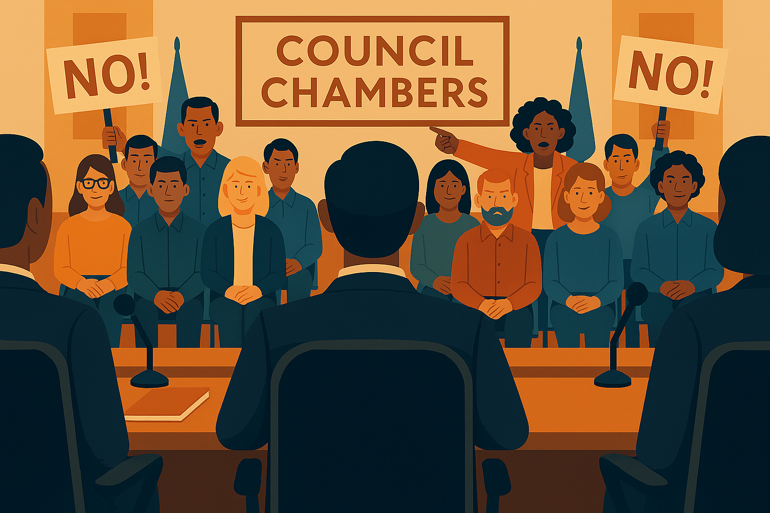
Public Comment

Slide 7
Quasi-judicial hearings
Applying existing policy to record facts
  Due process (notice and hearing)
  Public testimony
Avoid:
  conflicts and bias
  ex parte communication

Slide 8

Open Meetings Law

Slide 9
Open Meetings Law
Is it a public meeting?
  What body is meeting?
  How many present?
  What actions occurring?
Is it part of policymaking function?

Slide 10
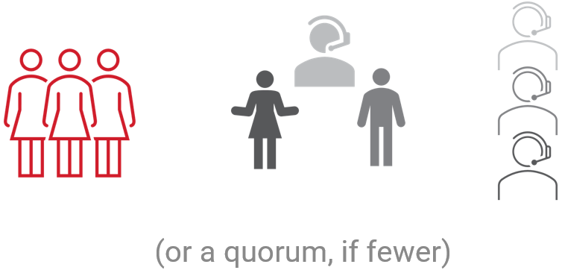

Open Meetings Law - Meeting

Slide 11
Open Meetings Law – Not Public Meetings
Not public meetings:
  social gatherings
  chance meetings
  individual communications
  not part of policymaking
Exempt electronic communications
  Not relating to merits or substance of public business

Slide 12
Open Meetings Law – Notice
Formal action or majority/quorum expected
Full & timely notice
  24 hours prior
  Designated place
  Specific information where possible

Slide 13

Open Meetings Law – Executive Sessions

Slide 14
Open Meetings Law – Executive Session Purpose
Property transactions
Attorney conference for legal advice on specific questions
Matters required to be confidential by federal or state law
Details of security arrangements/investigations
Negotiation matters
Personnel matters
Documents restricted from disclosure under CORA

Slide 15
Open Meetings Law – Executive Session Process
Motion: I move to enter into executive session pursuant to CRS 24-6-402(4) (__) for [statutory purpose] regarding [additional description].
2/3 vote
Recording required except for attorney-client privileged communications

Slide 16
Open Meetings Law – Executive Session Discipline
Someone needs to be in charge
No formal action
No “rubber-stamping”

Slide 17

Robert Sheesley
(303) 831-6411
rsheesley@cml.org

